Slide 1
Introduction to Chaos
Clint Sprott
Department of Physics
University of Wisconsin - Madison
Presented to Physics 311
at University of Wisconsin
in Madison, WI
on October 31, 2014
Notes:
Entire presentation available on WWW

Slide 2
Abbreviated History
Kepler (1605)
Newton (1687)
Poincare (1890)
Lorenz (1963)

Slide 3
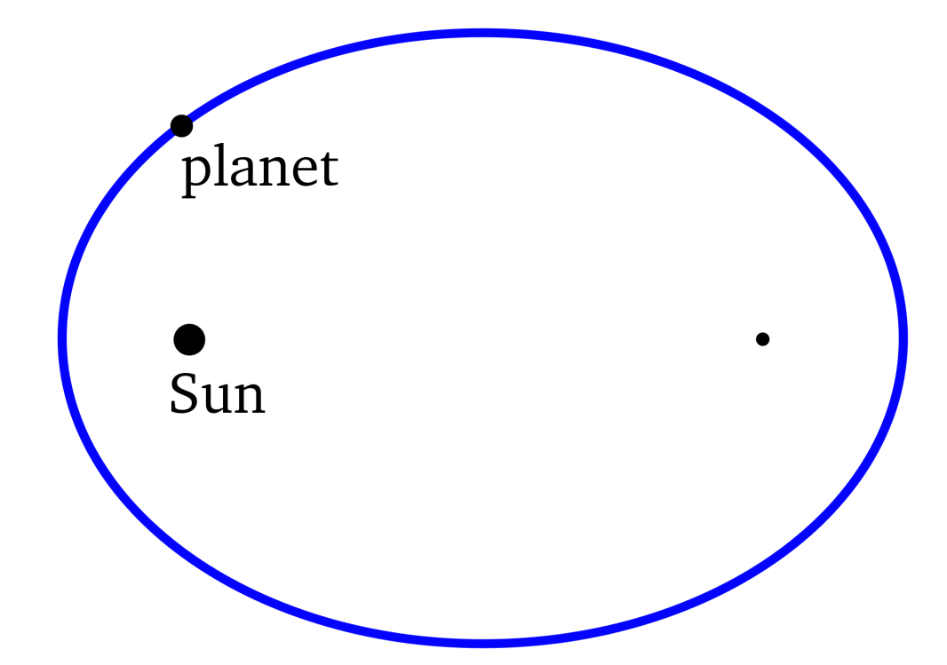
Kepler (1605)
Tycho Brahe
3 laws of planetary motion
Elliptical orbits

Slide 4
Newton (1687)
Invented calculus
Derived 3 laws of motion
F = ma
Proposed law of gravity
F = Gm₁m₂/r ²
Explained Kepler’s laws
Got headaches (3 body problem)

Slide 5
Poincare (1890)
200 years later!
King Oscar (Sweden, 1887)
Prize won – 200 pages
No analytic solution exists!
Sensitive dependence on initial conditions (Lyapunov exponent)
Chaos! (Li & Yorke, 1975)

Slide 6
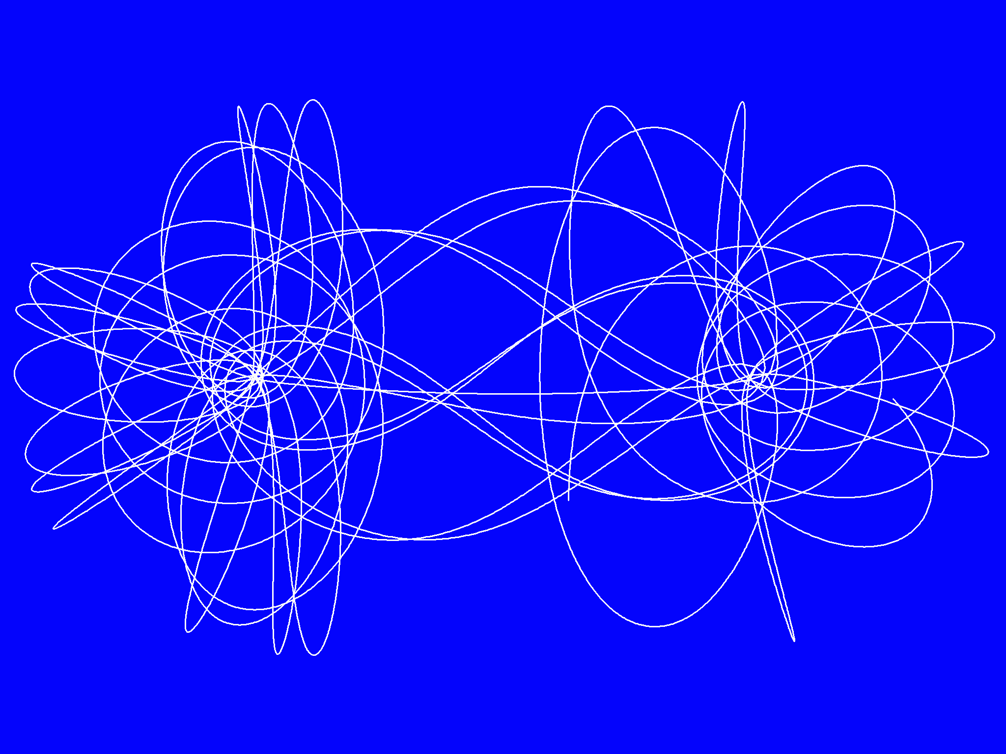
3-Body Problem

Slide 7
Chaos
Sensitive dependence on initial conditions (positive Lyapunov exp)
Aperiodic (never repeats)
Topologically mixing
Dense periodic orbits

Slide 8
Simple Pendulum
F = ma
-mg sin x = md²x/dt²
dx/dt = v
dv/dt = -g sin x
→ dv/dt = -x (for g = 1, x << 1)
Dynamical system
Flow in 2-D phase space

Slide 9
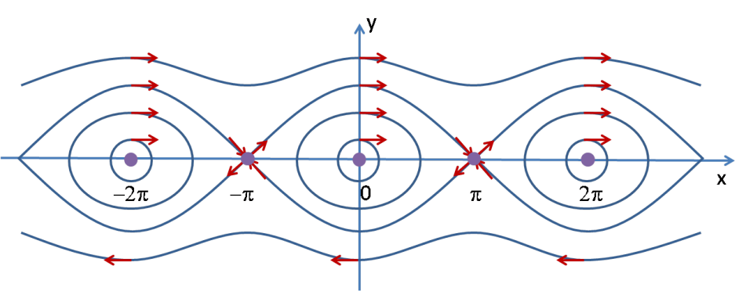
Phase Space Plot for Pendulum

Slide 10
Features of Pendulum Flow
Stable (O) & unstable (X) equilibria
Linear and nonlinear regions
Conservative / time-reversible
Trajectories cannot intersect

Slide 11
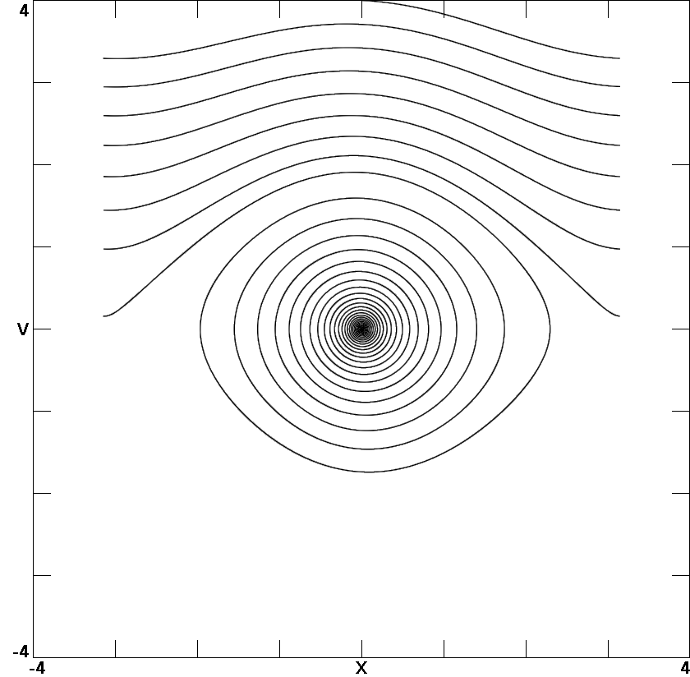
Pendulum with Friction
dx/dt = v
dv/dt = -sin x – bv

Slide 12
Features of Pendulum Flow
Dissipative (cf: conservative)
Attractors (cf: repellors)
Poincare-Bendixson theorem
No chaos in 2-D autonomous system

Slide 13
Damped Driven Pendulum
dx/dt = v
dv/dt = -sin x – bv + sin ωt
2-D 3-D
nonautonomous autonomous
dx/dt = v
dv/dt = -sin x – bv + sin z
dz/dt = ω

Slide 14
New Features in 3-D Flows
More complicated trajectories
Limit cycles (2-D attractors)
Strange attractors (fractals)
Chaos!

Slide 15
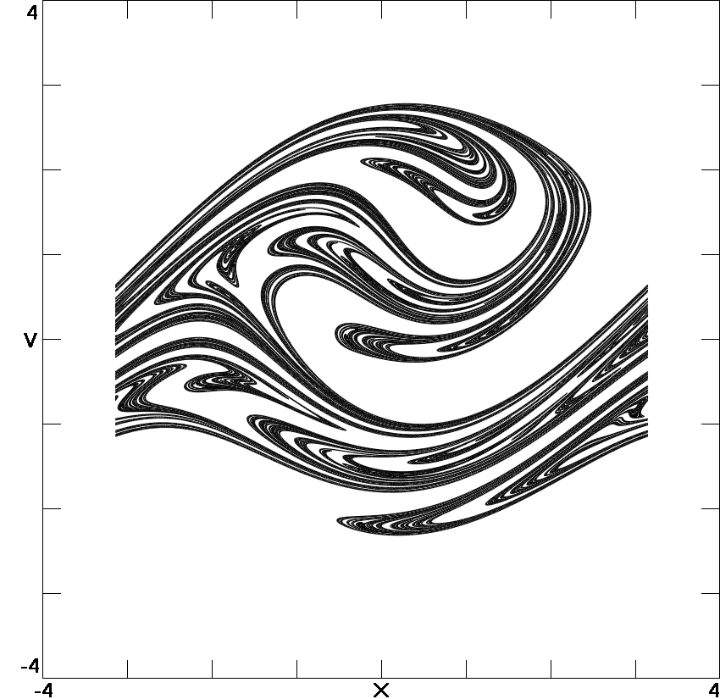
Stretching and Folding
Notes:
This models a driven pendulum with friction
Looks like those taffy machines at the fair
Show silly putty

Slide 16
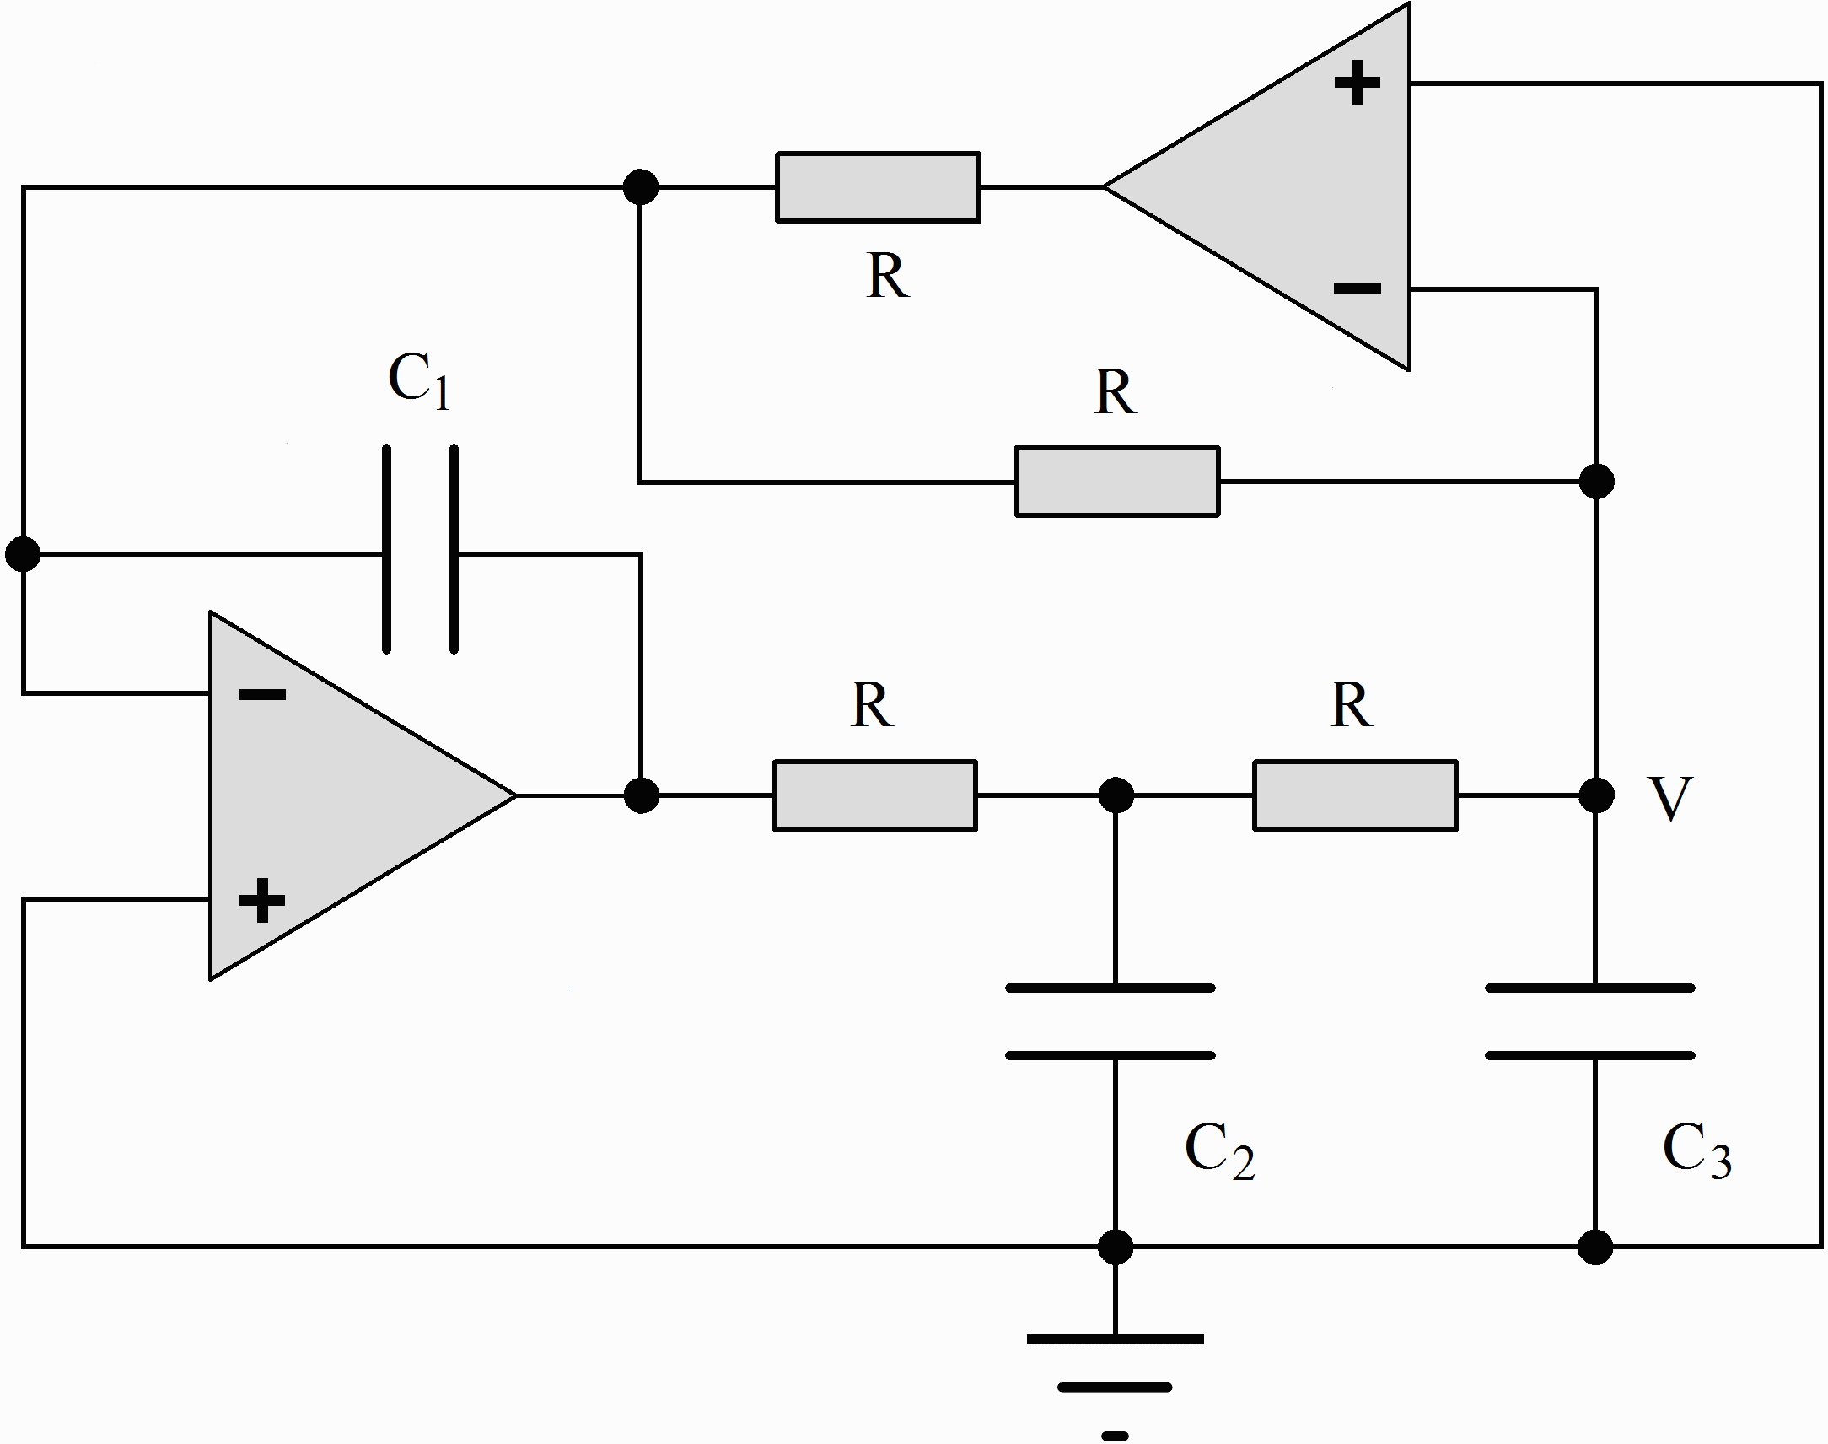
Chaotic Circuit
Notes:
This models a driven pendulum with friction
Looks like those taffy machines at the fair
Show silly putty

Slide 17
Equations for Chaotic Circuit
dx/dt = y
dy/dt = z
dz/dt = az – by + c(sgn x – x)
Jerk system
Period doubling route to chaos
Notes:
This models a driven pendulum with friction
Looks like those taffy machines at the fair
Show silly putty

Slide 18
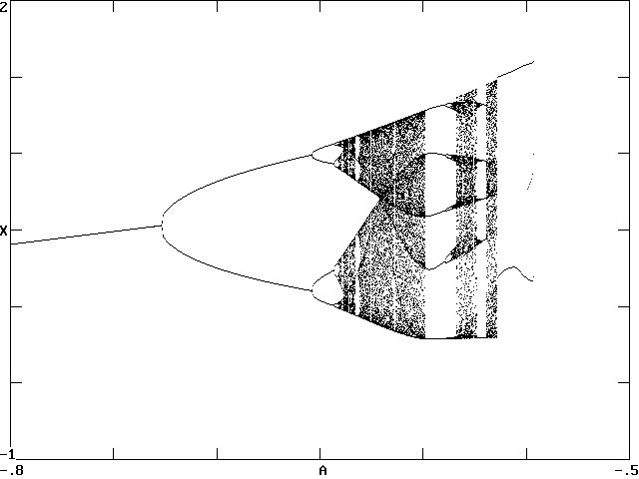
Bifurcation Diagram for Chaotic Circuit

Slide 19
Invitation
I sometimes work on publishable research with bright undergraduates who are crack computer programmers with an interest in chaos. If interested, contact me.
Notes:
This models a driven pendulum with friction
Looks like those taffy machines at the fair
Show silly putty

Slide 20
References
http://sprott.physics.wisc.edu/ lectures/phys311.pptx (this talk)
http://sprott.physics.wisc.edu/chaostsa/ (my chaos textbook)
sprott@physics.wisc.edu (contact me)

Slide 21
Props
Hard copy of slides
Driven chaotic pendulum
Ball point pen
Silly putty
Chaotic circuit / speaker

