Slide 1
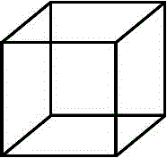
Multistability and Hidden Attractors
J. C. Sprott
Department of Physics
University of Wisconsin - Madison
Presented at
Shandong University
in Jinan, PRC
on October 23, 2017
Notes:
Entire presentation available on WWW

Slide 2
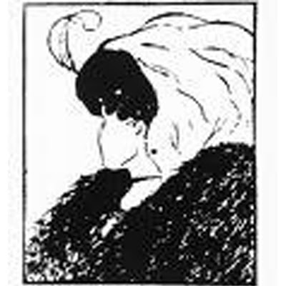
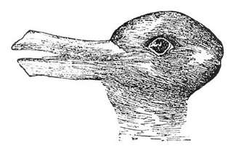
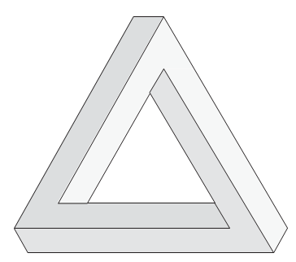
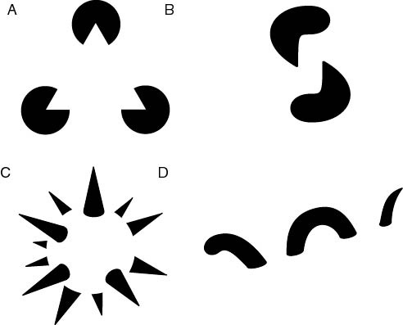
Multi(in)stability

Slide 3
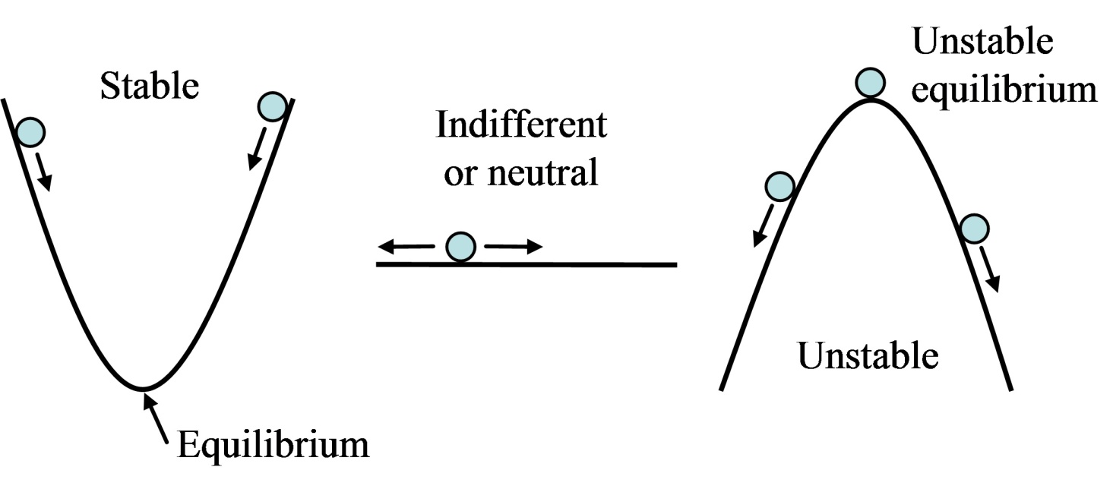
Types of Equilibria
Attractor
Repellor

Slide 4
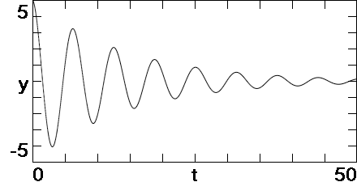
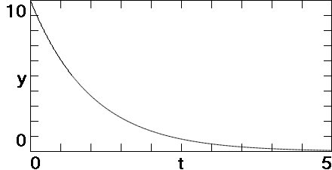
Dynamics near Attractor

Slide 5
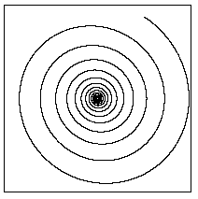
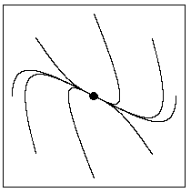
Phase Space
v
v
x
x
Focus
Node
A system with n physical dimensions
has a 2n-dimensional phase space.
In a linear system, there can be only one
attractor, and it is a point in phase space.

Slide 6
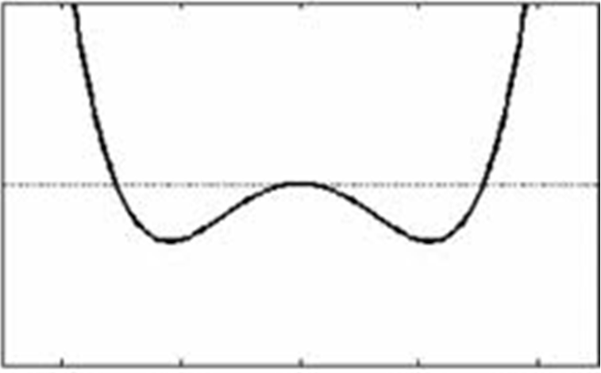
Two-well Oscillator
U
x
Three equilibrium points
Example of bistability
U = x⁴ – x²

Slide 7
Basins of Attraction
x’ = v
v’ = x(1–x²) – 0.05v

Slide 8
Direction of Flow
x’ = v
v’ = x(1–x²) – 0.05v

Slide 9
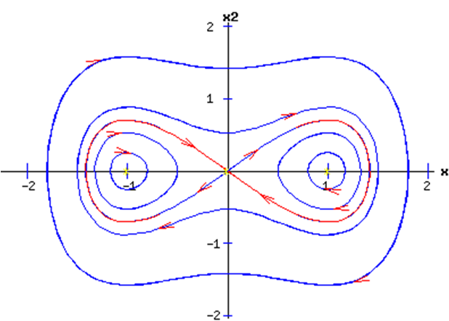
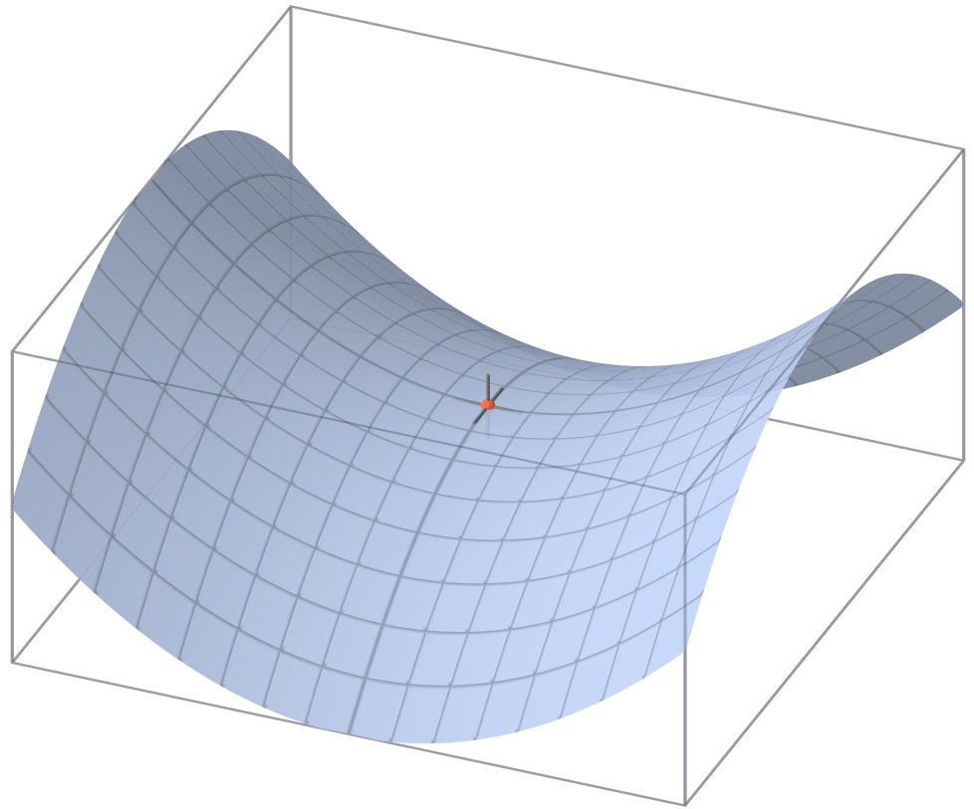
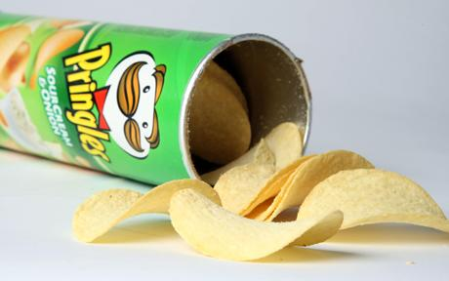
Saddle Point

Slide 10
Finding the Equilibria
x’ = dx/dt = v
v’ = dv/dt = x(1–x²) – 0.05v
x’ = dx/dt = v = 0 (no velocity)
v’ = dv/dt = x(1–x²) – 0.05v = 0 (no acceleration)
Three equilibria:
v = 0, x = 0 (unstable)
v = 0, x = 1 (stable)
v = 0, x = –1 (stable)
Calculation of stability is almost as simple (requires calculating the eigenvalues).

Slide 11
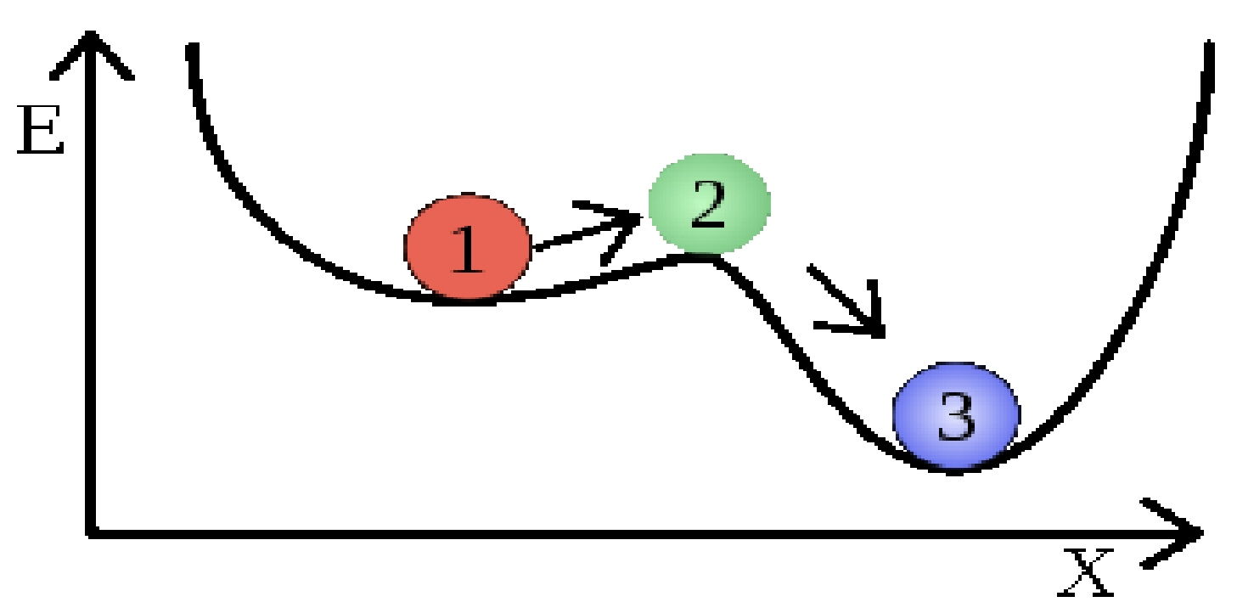
Metastability
“Tipping Point” (Climate system?)
All stable equilibria are attractors,
but not all attractors are equlibria.

Slide 12
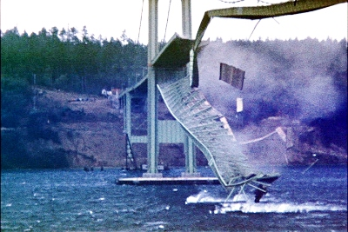
Tacoma Narrows Bridge
November 7, 1940
Washington State, USA
Two attractors!

Slide 13
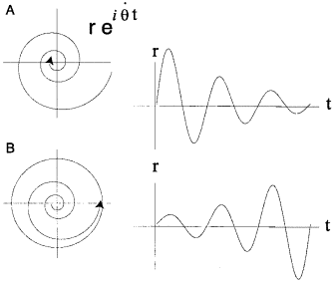
Hopf Bifurcation

Slide 14
Limit Cycles
x’ = y
y’ = z
z’ = –2.3z + y² – x

Slide 15
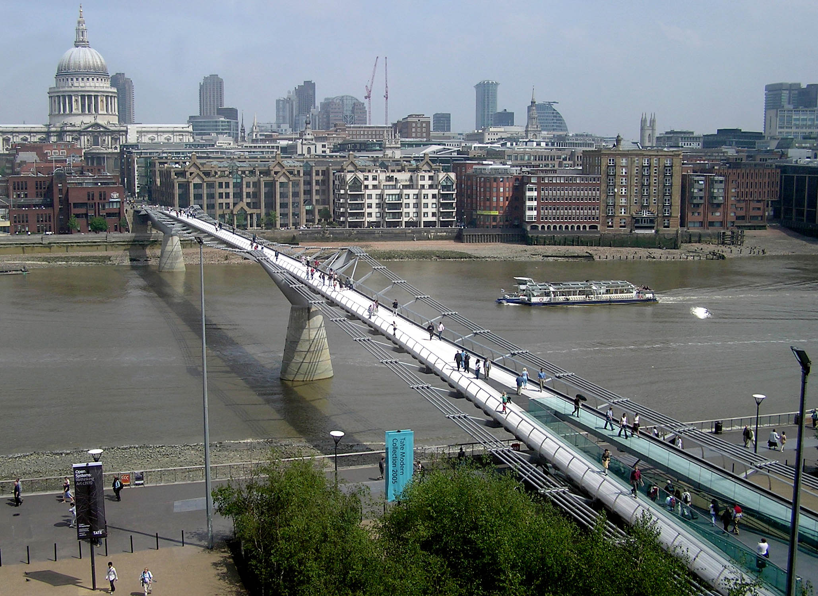
Millennium Bridge
June 10, 2000
London
Limit cycle!

Slide 16
Airplane Wing

Slide 17
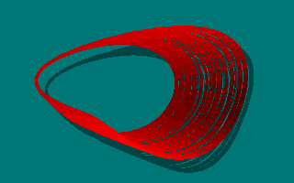
Period Doubling → Chaos
x’ = y
y’ = z
z’ = –az + y² – x

Slide 18
Strange Attractor Basin
z = 0
Basin
of strange
attractor
Unbounded
solutions
x’ = y
y’ = z
z’ = –2.02z + y² – x

Slide 19
Lunch with Ron Chen

Slide 21
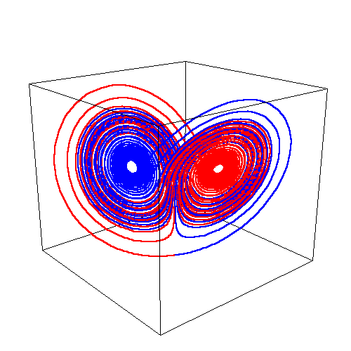
Tri-stability in Lorenz System
y = 0
x’ = 10(y–x)
y’ = 24.4x – y – xz
z’ = xy – 8z/3

Slide 22
Three Coexisting Attractors
x’ = yz + 0.01
y’ = x² – y
z’ = 1 – 4x

Slide 23
Three Basins
x’ = yz + 0.01
y’ = x² – y
z’ = 1 – 4x

Slide 24
Main Collaborators
Sajad Jafari
Amirkabir University of Technology, Terhan
Iran
Li Chunbiao
Nanjing University of Information Science and Technology, Nanjing, PRC

Slide 25
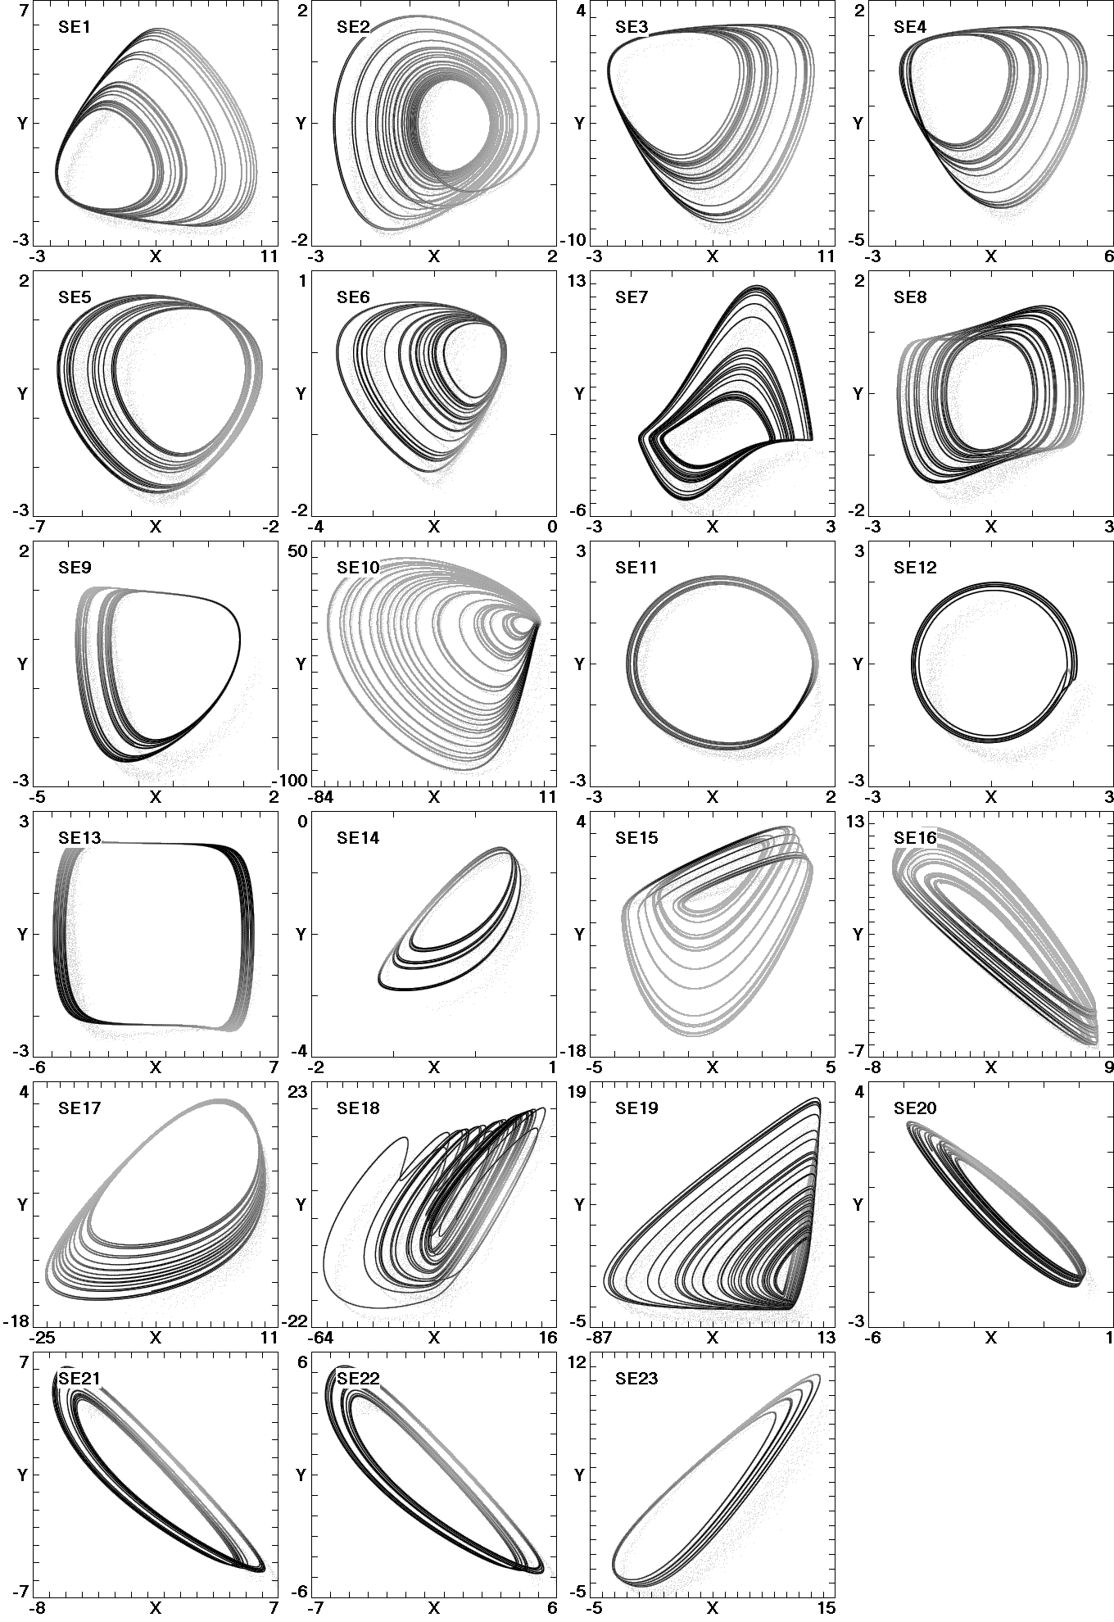
23 Additional Examples
All 3-D
quadratic
with 1 stable
equilibrium

Slide 26
Chaos with no Equilibria
17 cases
3-D
quadratic

Slide 27
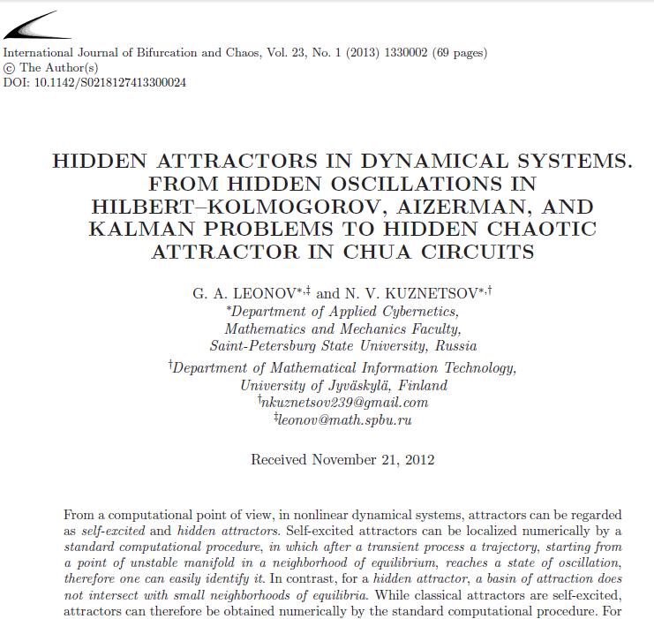

Slide 28
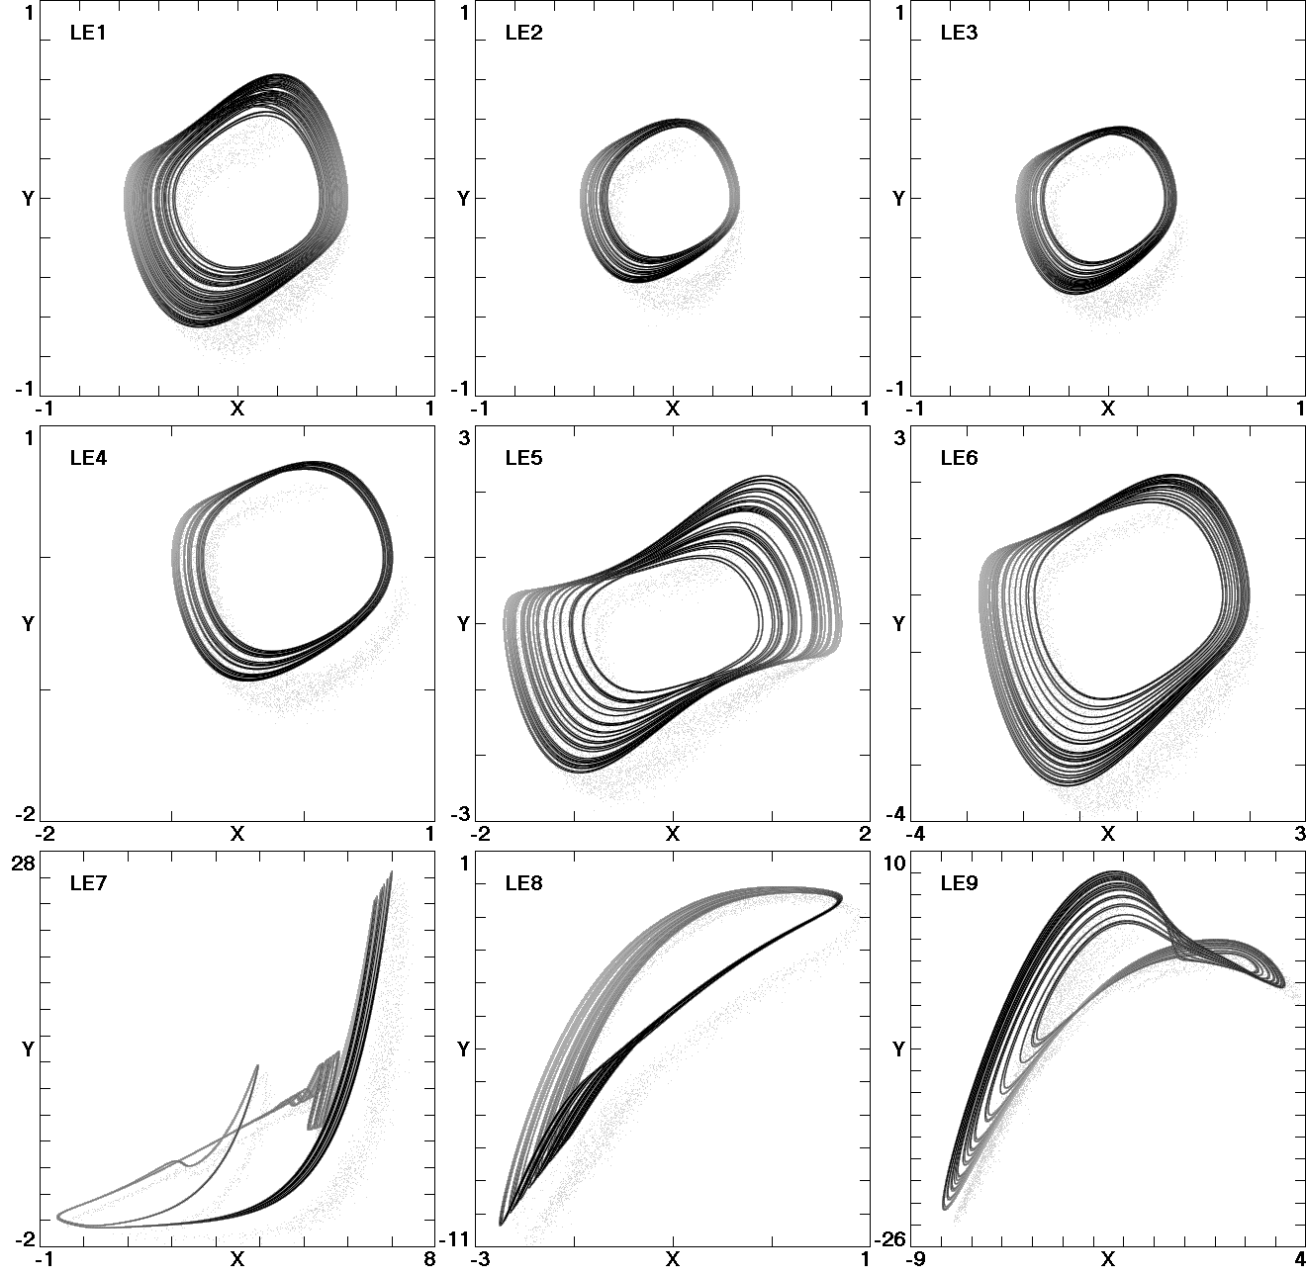
Chaos with Line Equilibrium
9 cases
Example:
x’ = y
y’ = yz – x
z’ = –x(1–15y–z)

Slide 29
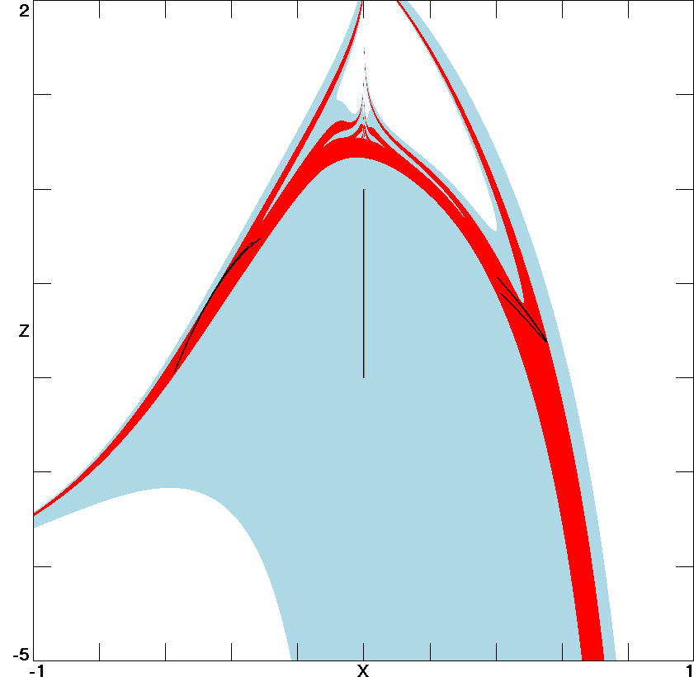
Basin of Line Equilibrium
y = 0
(0, 0, z)
x’ = y
y’ = yz – x
z’ = –x(1–15y–z)

Slide 30
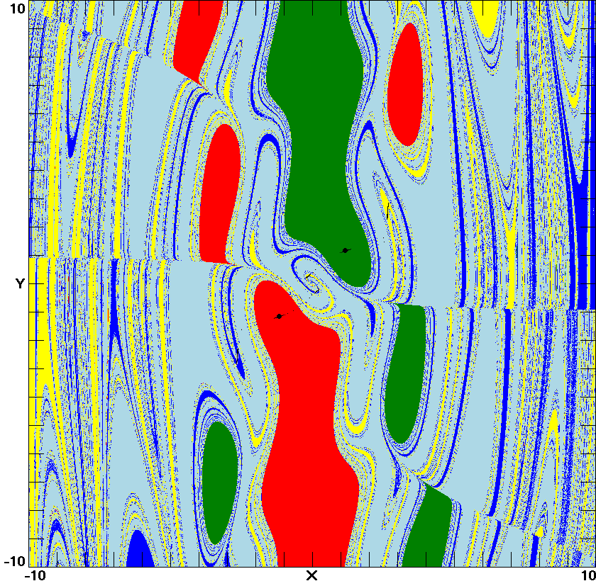
System with 5 Attractors
x’ = y + yz
y’ = yz – xz
z’ = –0.55z – xy + 0.8

Slide 31
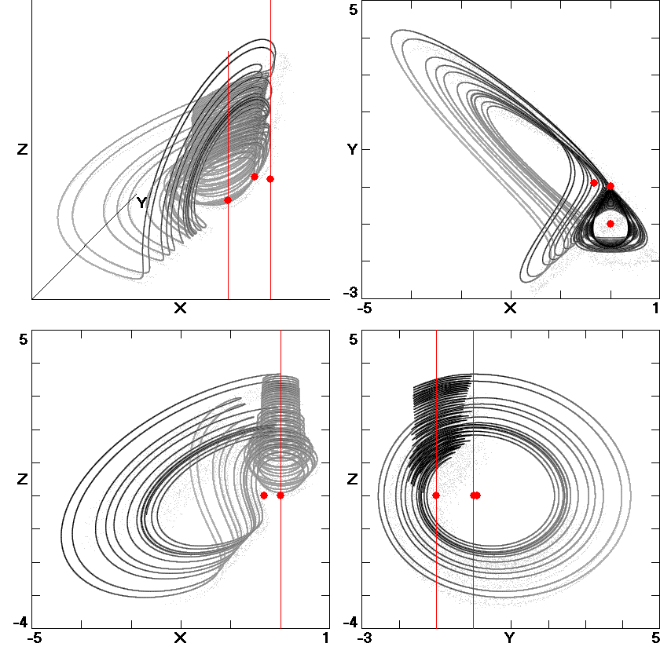
Chaos with Parallel Lines
(0, 0, z)
(0, −1, z)
x’ = x² – y – y²
y’ = –xz
z’ = 0.3x² + xy

Slide 32
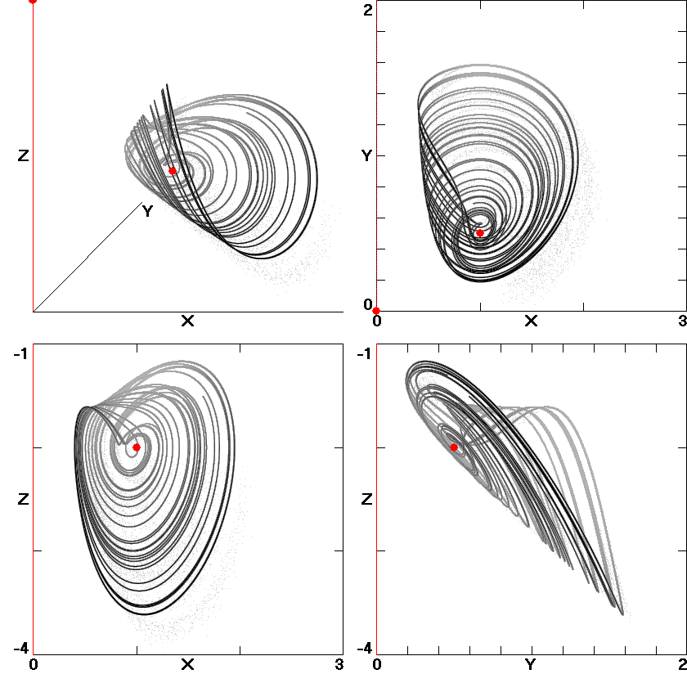
Chaos with Perpendicular Lines
(0, y, 0)
(0, 0, z)
x’ = x(2 + z)
y’ = x(x – 1)
z’ = x(1 – 4y) – yz

Slide 33
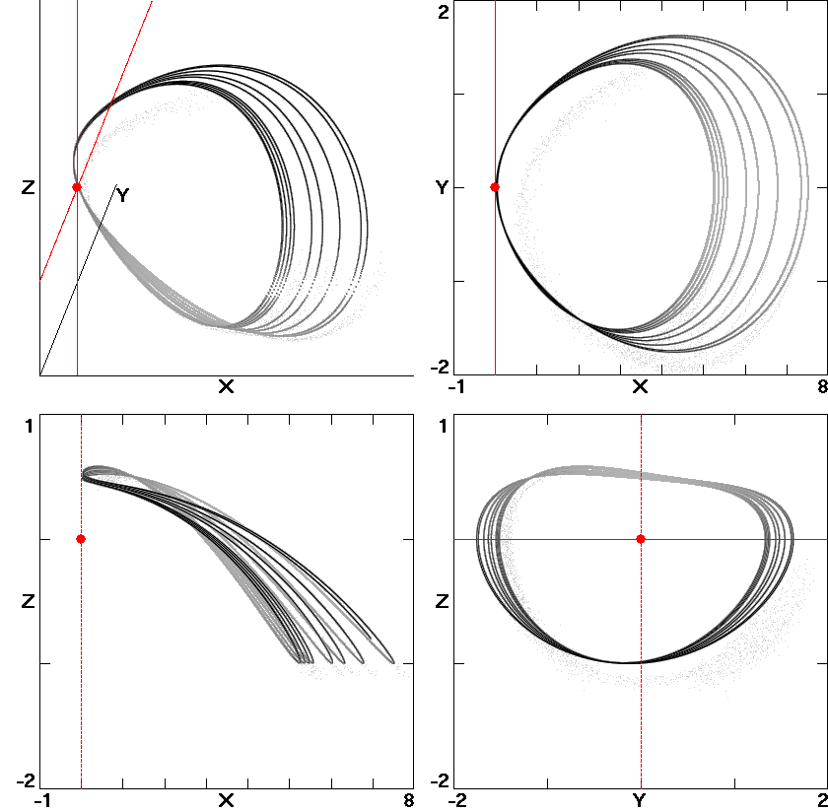
Chaos with Plane Equilibrium
(0, y, z)
x’ = xy
y’ = xz
z’ = x(1.54y² – x – xz)

Slide 34
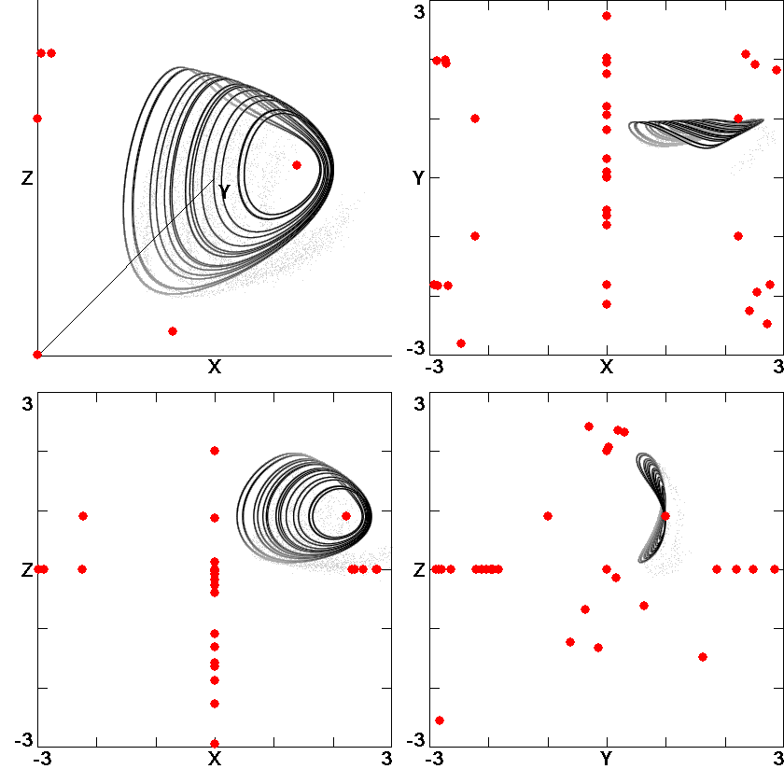
Chaos with Three Planes
f = xyz
x’ = f(−0.1y + yz)
y’ = f(2z − y² − z²)
z’ = f(−0.2x² + y²)

Slide 35
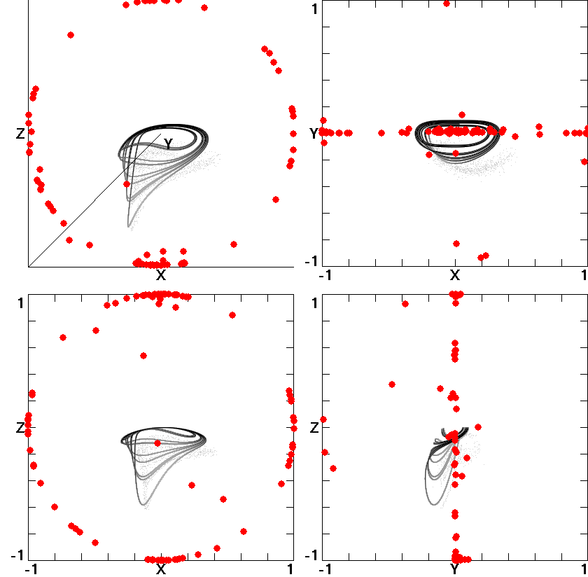
Chaos with Spherical Equilibrium
f = 1 – x² – y² – z²
x' = 0.4fy
y' = fxz
z' = – f(z + x² + 6yz)

Slide 36
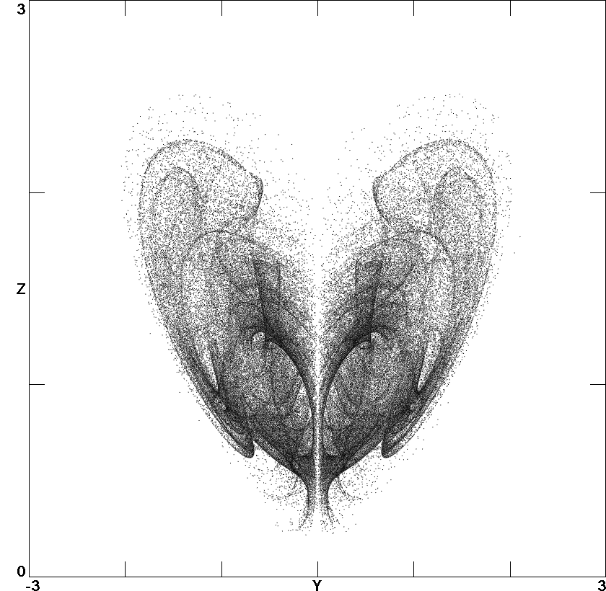
Hyperchaos with Line Equilibrium
x' = y – xz – yz + u
y' = 4xz
z' = y² – 0.28z²
u' = –0.1y

Slide 37
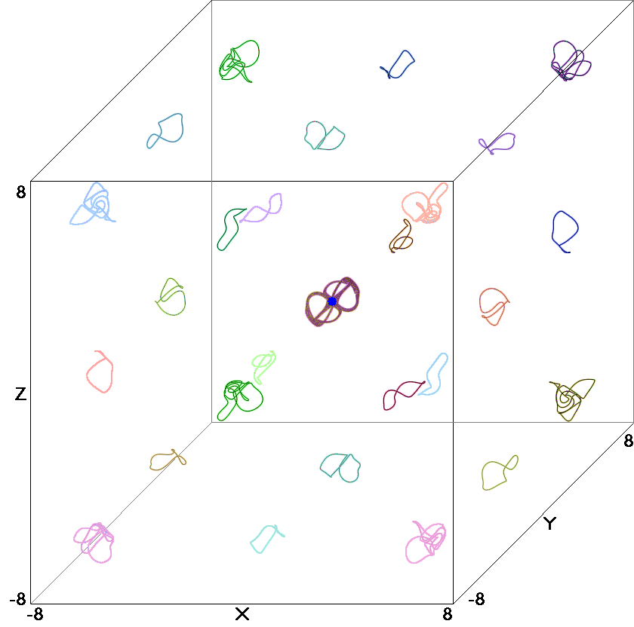
Infinite 3-D Lattice of Attractors
a = 4.75, b = 1
x’ = sin(ay) – bsin(x)
y’ = sin(az) – bsin(y)
z’ = sin(ax) – bsin(z)

Slide 38
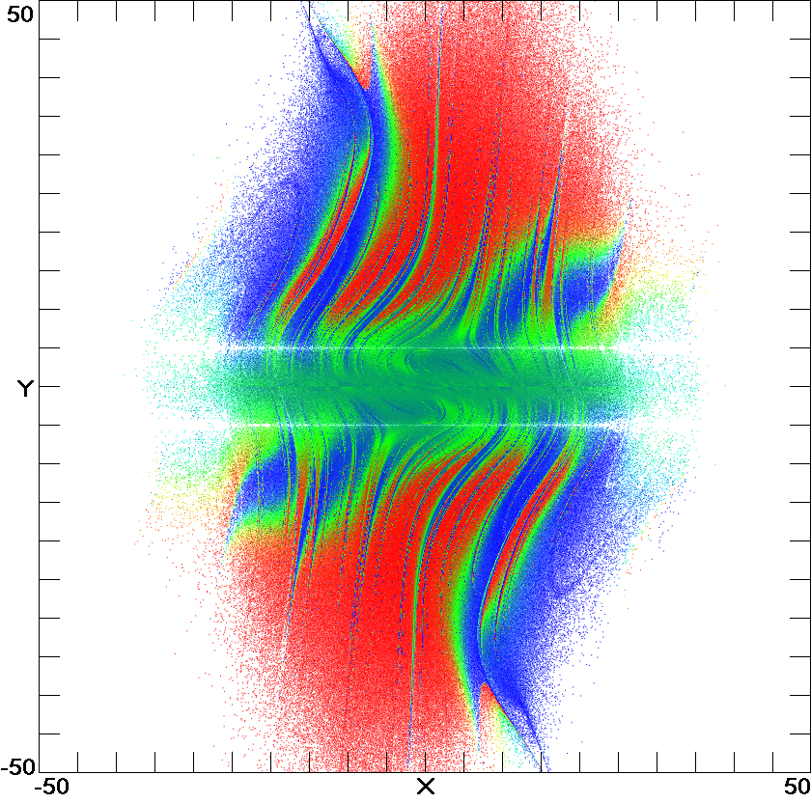
Hidden Attractor that Fills all Space
z = 0
x' = y
y’ = – x – zy
z’ = |y| – 5

Slide 39
Summary
Systems with multiple attractors are common and important.
Some of these attractors are “hidden” because they are not associated with any unstable equilibrium point.

Slide 40
References
http://sprott.physics.wisc.edu/ lectures/multistab.pptx (this talk)
http://sprott.physics.wisc.edu/chaostsa/ (my chaos textbook)
sprott@physics.wisc.edu (contact me)

Slide 41
Demos
Balls in troughs
Coin to flip
Metronome
Amplifier with microphone
Octant model
Sphere

