Slide 1
Is there a path to renewable fuels, and why would we want to go there?
Thomas W. Jeffries
Institute for Microbial and Biochemical Technology
Forest Products Laboratory
Department of Bacteriology
University of Wisconsin-Madison
Notes:
We are always at a juncture. What we do today will affect our tomorrow and all the days that come after. Just how much of an affect our decisions will have depends on how profoundly we think, and how much change we can, or are willing, to make. Today we are challenged by increasing demands on our natural and human resources, our financial capabilities, our personal, social and political wills, and our abilities to see through a fog of conflicting information, forces, and opinions.

Slide 2
Is there a path to renewable fuels?
Thomas W. Jeffries
Institute for Microbial and Biochemical Technology
Forest Products Laboratory
Department of Bacteriology
University of Wisconsin-Madison
Notes:
We are always at a juncture. What we do today will affect our tomorrow and all the days that come after. Just how much of an affect our decisions will have depends on how profoundly we think, and how much change we can, or are willing, to make. Today we are challenged by increasing demands on our natural and human resources, our financial capabilities, our personal, social and political wills, and our abilities to see through a fog of conflicting information, forces, and opinions.

Slide 3
Yes.
(more to come)
Notes:
We are always at a juncture. What we do today will affect our tomorrow and all the days that come after. Just how much of an affect our decisions will have depends on how profoundly we think, and how much change we can, or are willing, to make. Today we are challenged by increasing demands on our natural and human resources, our financial capabilities, our personal, social and political wills, and our abilities to see through a fog of conflicting information, forces, and opinions.

Slide 4
Why would we want to go there?
Notes:
We are always at a juncture. What we do today will affect our tomorrow and all the days that come after. Just how much of an affect our decisions will have depends on how profoundly we think, and how much change we can, or are willing, to make. Today we are challenged by increasing demands on our natural and human resources, our financial capabilities, our personal, social and political wills, and our abilities to see through a fog of conflicting information, forces, and opinions.

Slide 5
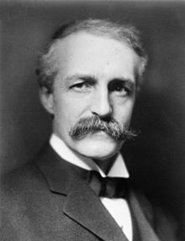
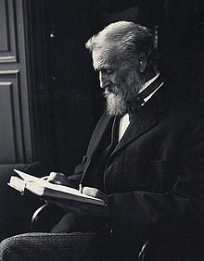
Legacy
Gifford Pinchot made us both heirs and stewards of the forest by asking that the uses we put it to are at least as valuable as those it finds when left alone.
Gifford Pinchot was a utilitarian who valued forests for their usefulness
John Muir felt that the wilderness was its own justification
Wikipedia

Slide 6
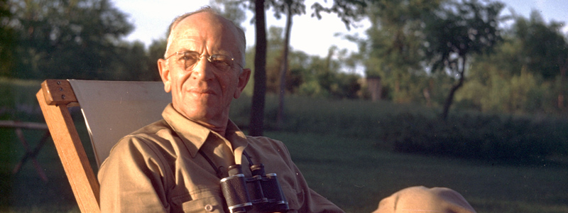
Legacy
Gifford Pinchot made us both heirs and stewards of the forest by asking that the uses we put it to are at least as valuable as those it finds when left alone.
Wikipedia
Aldo Leopold taught that we are of the land rather than the land of us.
Aldo Leopold Foundation

Slide 7
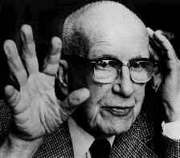
If we are to survive as a society we must find a way to convert our fossil energy capital into the means for renewable energy income.
R. Buckminster Fuller had a pervasive faith in human ingenuity

Slide 8
If we are to survive as a society we must find a way to convert our fossil energy capital into the means for renewable energy income.
This really has two parts:

Slide 9
Where there is a will there is a way…
If we are to survive as a society we must find a way...
to convert fossil energy capital
This really has two parts:
Into means for energy income

Slide 10
…but why is this an issue?
Supplies
Effects
…because fossil energy is essential
…because its use is detrimental

Slide 11
Is there a path to renewable fuels?

Slide 12
How do you convert the capital?
If we are to survive as a society we must find the will...
to convert fossil energy capital
Into means for energy income

Slide 13
Supplies
Projections for global petroleum
Australian Government (2009) Transport energy futures: long-term oil supply trends and projections

Slide 14
Supplies
In 2011, the globe consumed the equivalent of 12,275 million tonnes of oil.
Figures for the top 50 nations show how important fossil fuels remain
They supplied 87% of the world’s energy
Neither China nor the the United States joined the Kyoto accords when they were passed 15 years ago
Nature 29 November, 2012 491:654

Slide 15
If we are going to convert fossil energy capital in to the means for renewable energy income, we first have to price it.
The process implies a purchase
The means, while creating renewable income, will be depreciated

Slide 16
10 years
1: US spare capacity exhausted | 5: Saudis abandon swing producer role | 9: 9-11 attacks
2: Arab Oil Embargo | 6: Iraq invades Kuwait | 10: Low spare capacity
3: Iranian Revolution | 7: Asian financial crisis | 11: Global financial collapse
4: Iran-Iraq War | 8: OPEC cuts production 1.7 x10⁶ BPD | 12: OPEC cuts production 4.2 x 10⁶ BPD

Slide 17
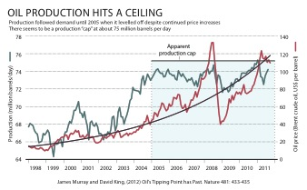

Slide 23
How do you price the means?
Must it be price competitive with fossil fuels?
…Or are there other factors?

Slide 24
Preindustrial: 280
Today: 398
Increase: 42%
Notes:
. Ever since the first International Geophysical Year in 1958, scientists have monitored the concentration of CO₂ at Mauna Loa in Hawaii. Measurements of CO₂ in ice and sediments indicate that pre-industrial levels were approximately 280 ppm – at or near the highest levels attained over the past 450,000 years. From 1958 to the present, the atmospheric concentrations have increased 19%.

Slide 25
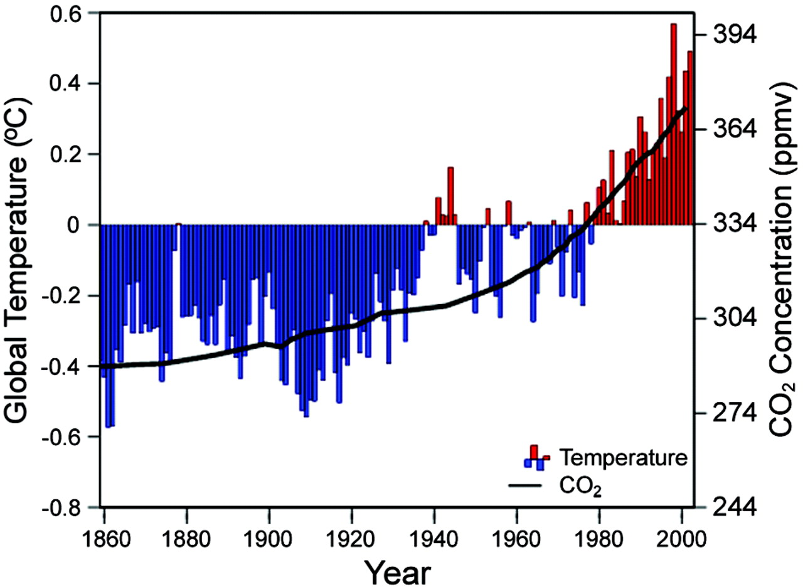
Since 1860, temperature has risen dramatically as CO₂ increased 31%
Karl, T. and Tremberth, K.E. 2003. Science 302:1721
Notes:
CO2 levels have risen 31% from pre-industrial levels
Today, as we meet here in Florida, the atmospheric concentration of greenhouse gasses is already more than 30% above the pre-industrial content, with this rise coming on top of a level attained only briefly four times in the past 450,000 years. We got to this level in about 100 years. Greenhouse gasses are now likely to be higher than they have been in the past 20 million years – roughly ten times longer than our species has been in existence. Surface and oceanic temperatures correlate closely with rises in CO₂. If we continue on our current path, by the end of this century, the atmospheric content of CO₂ will have more than doubled, – and according to the “warmest scenario” projections of the Intergovernmental Panel on Climate Change temperatures will be higher than they have been in 70 million years. Current analyses suggest that we passed outside of the realm of natural variation in temperature and CO₂ in about 1980. We are now entering a regime not seen since the extinction of the dinosaurs and the rise of the grasses that sustain our agricultural food supply.
http://www.ipcc.ch/

Slide 26
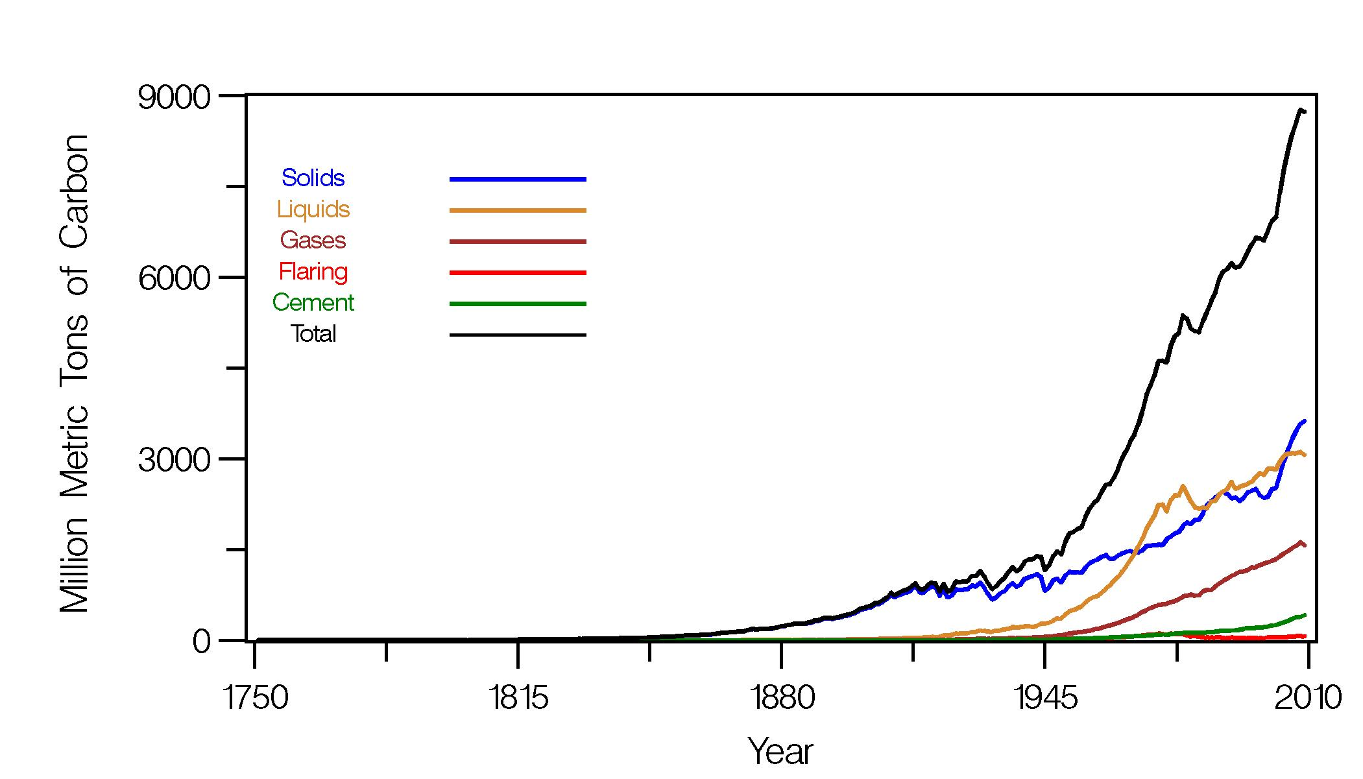
Carbon Dioxide Information Analysis Center
http://cdiac.ornl.gov/trends/emis/glo.html

Slide 27
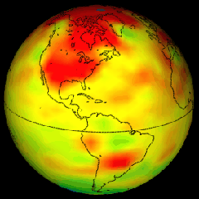
We are already seeing the effects of global change
Each decade
  Spring comes 5 days earlier
  Animal and plant ranges move 6 km further north
Ice thinning in arctic and alpine glaciers
Vegetation changes in arctic; melting of tundra
Increasingly severe weather
Changes are lagging behind the CO₂ level

Slide 28
The greenhouse effect has been recognized for 185 years
Joseph Fourier discovered greenhouse effect in 1827
John Tyndall discovered in 1861 that H₂O and CO₂ were largely responsible
Svante Arrhenius showed the role of CO₂ in 1896 and he and Chamberlin recognized the feedback effect with water by 1905
Notes:
Jean Baptiste Joseph Fourier (21 March 1768 – 16 May 1830) was a French mathematician and physicist best known for initiating the investigation of Fourier series and their applications to problems of heat transfer and vibrations. The Fourier transform and Fourier's Law are also named in his honour. Fourier is also generally credited with the discovery of the greenhouse effect.^{[1]}
John Tyndall FRS (2 August 1820 – 4 December 1893) was a prominent 19th century physicist. His initial scientific fame arose in the 1850s from his study of diamagnetism. Later he studied thermal radiation, and produced a number of discoveries about processes in the atmosphere.
Svante August Arrhenius (19 February 1859 – 2 October 1927) was a Swedish scientist, originally a physicist, but often referred to as a chemist, and one of the founders of the science of physical chemistry. He received the Nobel Prize for Chemistry in 1903. The Arrhenius equation, lunar crater Arrhenius and the Arrhenius Labs at Stockholm University are named after him.

Slide 29
Nature provides abundant solar energy
Total human energy use is about 1/9000 of the natural flow ^{1,2}
  Worldwide annual usage of fossil fuels was about 3.7 x 10²⁰ J in 1995
  total incident energy striking the surface of the earth – 237 W/m² or 3.5 x 10²⁴ J every year.
The real challenge is how to trap and use it efficiently
Biological systems provide us with a means to capture and store solar energy and CO₂
Karl, T. and Tremberth, K.E. 2003. Science 302:1721
R. J. Cicerone, Proc. Natl. Acad. Sci. U.S.A. 97, 10304 (2000)

Slide 30

Renewable, alternative energy and efficciency can take many forms
Wind
Nuclear
Biomass
Geothermal
Hydroelectric
Photovoltaics (solar)
Solar thermal
Green buildings
http://greenplanetethics.com

Slide 31
A policy proposal…
Carbon tax
  Tied to manufactured goods as well as use
Import duty on energy sources and goods
  Tied to carbon content and energy consumption in manufacturing
Minimum price for sale in the US
  ≈ $120 per barrel oil
    Inflation adjusted
  Any international import below price would go to building renewables, alternatives or improved energy efficiency

Slide 32
Trapping CO₂ in biomass reduces net accumulation
Photosynthesis traps 120 x 10⁹ metric tons of CO₂ every year
Equivalent to more than 5 times total energy consumption
14% of the world’s energy is derived from biomass today
Solar energy is a diffuse resource
While the total amount is great collection and storage are difficult
Biomass is ideal for mitigating climate change
Notes:
If there were ways to hold the wilderness that we love and the goods that we want in the same hand, we would do so, but experience belies such might and we are left with choices. It is possible to have progress and preservation, but it requires a new and more intense way of working within the confines of our culture while setting aside the natural land, which by its difference defines our humanity.

Slide 33
The United states has abundant biomass resources
Recoverable corn residues: 150 x10⁶ tons
Cereal straws: 60 x10⁶ tons
Corn fiber: 4 x10⁶ tons
  Sufficient for 12 billion gallons of ethanol
Energy crops and overstocked stands ???
Annual wood use:
  Wood Products 300 x10⁶ tons
  Fuel Wood 50 x10⁶ tons
  Total Use 350 x10⁶ tons

Slide 34
Adding value
Films
Biochemical and
Metabolic
Engineering
Adhesives
Polymers
Precursors
Fuels
Chemicals
Modified lignin
Modified fibers
Enzymatic
Conversion
Fermentable sugars
Polymeric lignin
Fractionated fibers
Pulping and
Pretreatments
Oxidative and extractive treatments
Chemical and mechanical pulping
Acid and alkali treatment
Autohydrolysis
Fiber and oil crops
Lignocellulosic
Feedstocks
Low density hardwood species
Underutilized processing wastes
Wood and agricultural harvest residues
Value
Recycled papers and wood waste
Sludges from recycled fibers

Slide 35
Several different commercial products could be formed from biomass sugars
Ethanol, isobutanol (fuel, precursor)
  Currently produced from corn and LC
Polyhydroxyalkanoates (packaging, polymer)
  Currently produced from corn starch
Polylactic acid (packaging, polymer)
  Currently produced from corn starch
Acetic acid
Sulfur free lignin

Slide 36
Storage material | Energy type | MJ per kg | Direct uses
Hydrogen (700 bar) | Chemical | 123 | Experimental automotive engines
Diesel | Chemical | 46 | Automotive engines
Gasoline | Chemical | 44 | Automotive engines
Propane (including LPG) | Chemical | 46.4 | Cooking, home heating, automotive engines
Biodiesel | Chemical | 37.8 | Automotive engines
Fat (animal/vegetable) | Chemical | 37 | Human/animal nutrition
Butanol/isobutanol | Chemical | 36.6 | Automotive engines
ethanol | Chemical | 26.8 | Automotive engines
E85 | Chemical | 25.2 | Automotive engines
Coal | Chemical | 24 | Electric power plants, home heating
Carbohydrates (sugars) | Chemical | 17 | Human/animal nutrition
Protein | Chemical | 16.8 | Human/animal nutrition
Wood | Chemical | 16.2 | Heating, outdoor cooking
TNT | Chemical | 4.6 | Explosives
Gunpowder | Chemical | 3 | Explosives
Lithium battery | Electrochemical | 1.8 | Portable electronic devices, flashlights (non-rechargeable)
Lithium-ion battery | Electrochemical | 0.72 | Laptop computers, mobile devices, some automotive engines
Alkaline battery | Electrochemical | 0.59 | Portable electronic devices, flashlights
Nickel-metal hydride battery | Electrochemical | 0.288 | Portable electronic devices, flashlights
Lead-acid battery | Electrochemical | 0.1 | Automotive engine ignition
Source: http://en.wikipedia.org/wiki/Energy_density

Slide 37
Biotechnology could modify complex traits in plants
Introduce or amplify complete biochemical pathways
  Transport, regulation, catalysis, secretion, storage
Faster growing trees for fuel, fiber and CO₂ management
Increase drought resistance
Enable salt tolerance
Re-engineer lipid or extractives metabolism
Produce secondary metabolites
  Osage orange, insect resistance

Slide 38
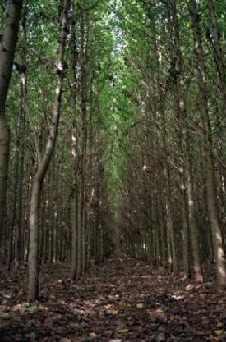
Genomics could improve tree properties
All 19 poplar chromosomes are now sequenced
Small genome size only 4X larger than Arabidopsis and 40X smaller than pine
Rapid juvenile growth
Ease of clonal propagation
Rapid transformation and regeneration
Extensive genetic maps
http://genome.jgi-psf.org/poplar0/poplar0.home.html

