Slide 1
From Here To There:
From Lawful Neuroscience
To The Unruly Realities of Every Day Human Adaptation
OR
Are Mother-Infant Smiles
Beacon Lights of Evolution & Civilization?
Bernard Z. Friedlander, Ph.D.
Version 13.10.15PFFF
© Bernard Z. Friedlander 2013
Research Professor of Human Development, Emeritus
Department of Psychology, University of Hartford
Regularly Contributing Member
CCSS—University of Wisconsin-Madison
B Z F Contact:
bzf303@aol.com
bzf202@gmail.com
Tuesday, Oct 15, 2013
Chamberlin Hall Rm 4274
1150 University Avenue
12:05-1 PM

Slide 2
From Here To There:
From Lawful Neuroscience
To The Unruly Realities of Every Day Human Adaptation
OR
Are Mother-Infant Smiles
Beacon Lights of Evolution & Civilization?
An Opera
with
An Overture and
Three Acts
Act 1. A Challenging Issue In Getting From Here To There
–Just One of Thousands
Slides 6-14
Act 2. Problems In Getting From Here To There
Slides 15-39
Act 3. Breaking New Trails To Get From Here to There
Slides 40-55

Slide 3
Overture
I don’t know if Clint Sprott and Robin Chapman receive the credit they deserve, now in the 20th year of the Chaos and Complex Systems Seminar. They are entitled to a great deal of appreciation for maintaining what may be one of the best interdisciplinary symposium series in American university life. Their diligence and attention to detail are remarkable– to have kept this program firmly on its tracks for so long, and with the continuity that carries our gatherings on informally throughout the summer vacation season as well as during the regular academic year program. The high quality of the discourse in this series, across so broad a horizon of ideas, is a constant challenge to serious thought across a wide geography in the world of knowledge.
In our era of hyper-specialization within increasingly narrow fields of study, that is an exceptionally valuable asset to university life that is very often
honored in theory and neglected in practice. When interdisciplinary thinking falters, scholars and society at large pay an increasingly high price.
In preparing my presentation for today I have done my best to live up to the high standards Clint and Robin pursue here. The broad range of ideas in this venture reflect the challenge posed by the intricacy and breadth of the concepts of chaos and complexity this Seminar is designed to pursue.

Slide 4
From Here To There:
From Lawful Neuroscience
To The Unruly Realities of Every Day Human Adaptation
OR
Are Mother-Infant Smiles
Beacon Lights of Evolution & Civilization?
Bernard Z. Friedlander, Ph.D.
Version 13.10.15p
NOTE
This Presentation Version of the material is cut to the bone in order to allow time for Seminar discussion. Lots of connective tissue and important elaborations are not included here. Some of my favorite slide sequences are lying on my computer’s equivalent of “the cutting room floor” – where they are being carefully retained. Several of these sequences appear at the end of this PDF, in and Addendum, following the partial Bibliography.
This complete text will be available free by sending requests to me at bzf202@gmail.com. To get your copy soon please give me your e-mail address today or send for it quickly, to receive PDF distribution via e-mail.
My friend and collaborator Cameron Holmes was extremely helpful to me in formulating parts of this presentation and I am grateful to him for his efforts. I am also grateful to my grandson, Noah Friedlander, for his patience when he helped Grandpa learn some of the computer techniques that make this presentation possible.

Slide 5
B Z Friedlander
From Here To There: From Lawful Neuroscience To The Unruly Realities of Every Day Human Life
or
Are Mother-Infant Smiles The Beacon Lights of Evolution & Civilization?
Introduction
A primary challenge in the world of knowledge is to figure out how things are and how they get that way.
In the human sciences that means people: how we are and how we get this way. So, we study behavior in virtually all its forms, and development across the life span, to study how we change with the passage of the years.
To fill out the picture, if we’ve got any sense, we study evolution. We can’t understand the real story of how people get the way we are unless we think very seriously about how our species got to be the way it is.
In all the years I’ve been studying how people get the way we are, and how our species got the way it is, I have never yet encountered a single narrative or analysis that so well expresses as this one does the realities of our evolution as a species, and our emergence as fully formed individual and social human beings.
That’s why I’m starting this scientific session of our Seminar with a book ad and a book report. For fifty five years I have been studying various aspects of human development and human evolution. In all that time I have travelled through vast territories of reading, research, teaching, publications, symposia, conferences and professional consultations across the U S and in the U K, The Netherlands, Italy, and Japan. And I’ve worked with leading figures in a broad range of fields of study.
Marina Chapman, and her helpers, tell a story that gets to the core of human uniqueness like no other single work I know.
B Z F

Slide 6
Act
One
Slides 6-14
A Challenging Issue
In
Getting
From Here To There–
–Just One of Thousands

Slide 7
From Here To There:
From Lawful Neuroscience
To The Unruly Realities of Every Day Human Adaptation
OR
Are Mother-Infant Smiles
Beacon Lights of Evolution and Civilization?
Our Primary Question–The Tough One
Can we adapt burgeoning progress in disciplined neuroscience to the disorderly theaters of real life in which human individuality and social narratives have always unfolded?
Our Second Question–Much Easier !
OF COURSE ! CERTAINLY ! WITHOUT A DOUBT !
(Details considered below, and elsewhere.)

Slide 8
Restate The First Question
? ? ?
HERE:
Foundations of Natural Sciences
Attuned To
FUNGIBLE agents
CONSTANT properties
REGULATED environments
STABLE relationships
MORE REPLICABLE outcomes
THERE:
Foundations of Life/Behavior Sciences
Attuned To
UNIQUE agents
VARIABLE properties
DYNAMIC Environments
VARIABLE Relationships
LESS REPLICABLE Outcomes
Neuro-Behavioral Sciences
Caught In The Middle?
Scientific Heritage Operating Territory
The Natural Sciences Living Bodies, Brains & Minds
Is the difference between these domains of science
A Prescription for Culture Conflicts, Misunderstandings, Error?

Slide 9
Q 1. What happens in babies’ brains, minds, faces when they see Mom smile?
Q 2. What does this tell about the whole train of neural-behavioral “happenings?”
Q 3. What are the neuromuscular interactions, and what do they signify?

Slide 10
Babies’ reciprocal, “recognitive” smiles are a profoundly puzzling challenge:
Q 4. What do they tell us about:
Brain, mind, learning, recognition, causality, “effectance” and “self?”
Those are a few of the ramifications of this presentation.

Slide 11
These Are Extremely Important Issues.
Q 1-3: All involve incredibly complicated interactions among
babies’ earliest post-natal perceptual-cognitive-signaling-motor-
behavioral adaptations. These adaptations all entail voluntary,
optional, non-reflexive executive action.
Q 4: Marks the foundations of babies’ social bonding–
the bed rock of children’s effective, coherent relationships with other individuals, their society and their culture. Effects of these processes can have life-long impacts.
Reciprocal social smiles between infant and caregiver are the Foundation Clause of the
Human Social Contract !
And I say this knowingly, of the many important meanings and connotations that statement implies.

Slide 12
A.
Is This The First Human
Neuromuscular, Non-Reflex, Optional,
Intangible, Signal-Intensive
Social Contract?
The First Social Contract
We the People, you and I, in order to form a more perfect Union, insure domestic Tranquility, provide for the common Defense, promote the general Welfare, and secure the Blessings of Liberty to ourselves and our Posterity, do ordain and establish that we will do our best to bring Love, Joy, Peace and Interdependence to Each Other and our clans Forever–as prevail RIGHT NOW.

Slide 13
B.
United States Version of “The Social Contract”
Preamble to the U.S. Constitution
We the People of the United States, in Order to form a more perfect Union, establish Justice, insure domestic Tranquility, provide for the common Defense, promote the general Welfare, and secure the Blessings of Liberty to ourselves and our Posterity, do ordain and establish this Constitution for the United States of America.
C.
To What Extent is Fulfillment of B
Contingent Upon The Success of A?

Slide 14
What Are The Lessons Here?
Follow any good news media–the political, economic, environmental,
health, judicial, international happenings, including the doings of the ordinary people as well as of the movers and the shakers.
Think hard about what you see and hear.
As People, writ large, how well are we fulfilling the complexities and Social Contracts of our family, community, and socio-cultural values?
Is it a challenge to the worlds of knowledge & science, writ large, to participate in the study and amelioration of what that study tells us?
Are there risks? Are there alternatives? Is there a mission to serve?
Can we prioritize our decisions?
Curtain, Act 1

Slide 15
Act Two
Slides 15-39
Problems in Getting
From Here to There

Slide 16
Restate The First Question
? ? ?
HERE:
Foundations of Natural Sciences
Attuned To
FUNGIBLE Agents
CONSTANT Properties
REGULATED Environments
STABLE Relationships
MORE REPLICABLE Outcomes
THERE:
Foundations of Life/Behavior Sciences
Attuned To
UNIQUE Agents
VARIABLE Properties
DYNAMIC Environments
VARIABLE Relationships
LESS REPLICABLE Outcomes
Neuro-Behavioral Sciences
Caught In The Middle?
Scientific Heritage Operating Territory
The Natural Sciences Living Bodies, Brains & Minds
Is the difference between these domains of science
A Prescription for Culture Conflicts, Misunderstandings, Error?

Slide 17
Accumulating evidence
Suggests that sciences of
Brain, Mind, and Behavior
Are more likely to be in
The Green Zones of Variable Realities
Than
The Blue Zones of Constant Realities
(Review Slide 16)
Let’s look at two provocative sets of
Data and Analysis.

Slide 18
A New Light Switches ON In Bernard’s Mind–At First, Only Dimly
At this Seminar, on April 13, this year, Professor
Tony Stretton, UW Zoology, reported strange findings
In his highly authoritative research with flatworms:
Electron microscopy showed irregular synaptic firings in the usually stable neural responses of Ascarias, related to
tiny variations in previously unknown neuropeptide “broths” that bathe individual neurons.
Small changes in the chemical micro-environment appear to
produce small changes in synaptic firing, muscle twitching and
wiggle movement behavior in response to standard stimuli.
This must mean something. But WHAT ?
Maybe factors that influence synaptic firing are more complicated than we thought.
There seems to be some variability in this picture !

Slide 19
There seems to be some variability in this picture ?
BUT THAT ISN’T THE WAY IT’S SUPPOSED TO BE !
Sherrington, or somebody, proved ALL OR NONE synaptic firing with standard stimuli. Isn’t that THE LAW?
But Stretton’s work shows variability appears–where Constancy was thought to apply.
Could That Basic “Law” Have Some Loopholes?
Could “the Law” be WRONG?
This one may deserve a lot of thinking !

Slide 20
WWW.NEUROPEPTIDES.NL
(The Gospel, According to Google)
Neuropeptides are small protein-like molecules used by neurons to communicate with each other. They are neuronal signaling molecules. The brain largely functions by virtue of neuropeptides.
Neuropeptides are expressed and released by neurons, and mediate or modulate neuronal communication by acting on cell surface receptors. The human genome contains about 90 genes that encode precursors of neuropeptides. Neuropeptides can be clustered in at least 10 subfamilies according to structural features.
The Neuropeptide Database is the internet resource to data about all known neuropeptides, their genes, precursors and expression in the brain.
WOW!
Ninety genes and at least 10 subfamilies.
That Means A Lot of Variability !

Slide 21
If This Is True
And There’s No Reason to Suppose
It Isn’t True—
**
That’s A Huge Problem For Theory and
Practical Applications In Neuroscience,
In Medical Diagnosis and Treatment,
and in Behavior Studies !

Slide 22
Problem: *
What is the
Functional Level of Variability
At Which
The Electrochemistry
Underlying Actions of
Brain, Mind And Behavior Are
Really Determined?
Neuropeptides? Cells? Cell Assemblies? System Integrations?
Inter-organism Joint Attention?
ALL FIVE–Somehow Intermingled?
*

Slide 23
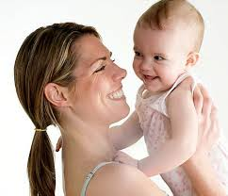
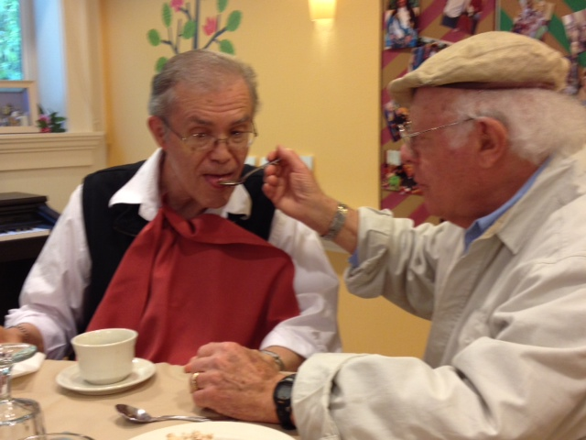
Where should diligent investigators focus their attention if they want to find out what really accounts for the high-speed, dynamic changes in facial expressions in situations like this? I don’t think we know very much about the role of time in shaping
Infants’ responses to rapidly changing stimuli. I can tell some research anecdotes on this topic–not supported by experimental data.
Google
This prominent, revered physician can no longer formulate nor express his thoughts, nor hold a spoon, due to his advancing Parkinsons–combined with other pathologies. His performance improves when his beloved wife is present. Can thinking about neuropeptides help us account for that level of variability? Can these neuropeptide broths change their composition rapidly? Does anyone know?
Photo: Peter Cowley

Slide 24
*
Could it be that
Thinking New Thoughts About
Levels of Differentiation
&
Modes of Integrative Generalization
Might Play A Role in
Helping to Sort Things Out?

Slide 25
Is This A
Suitable Challenge
For Us To Be Dealing With
In the UW
Chaos and Complex Systems Seminar?

Slide 26
Here are further very important views on
Variability
In neural tissue

Slide 27
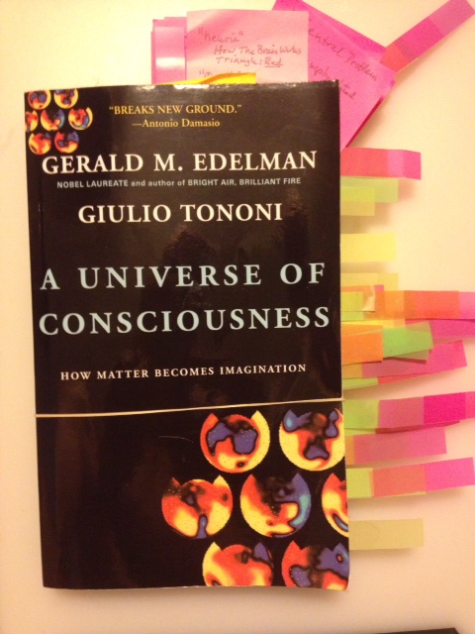
Gerald Edelman and Giulio Tononi are
Two of the most authoritative neuroscientists in the field...
…and Professor Tononi is on the Psychiatry faculty here at UW.

Slide 28
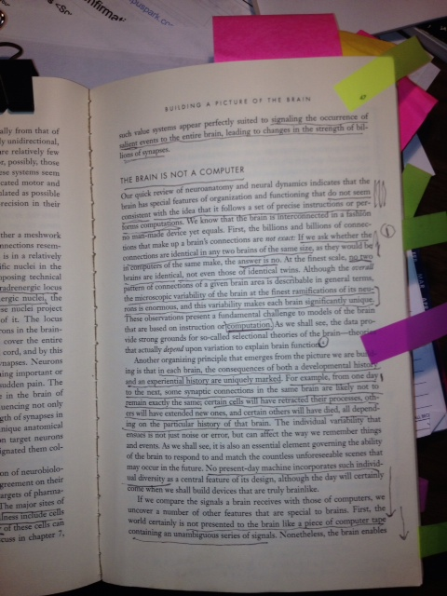
A Universe Of Consciousness Critical Page–Page 47

Slide 29
Edelman & Tononi A Universe Of Consciousness Page 47
Critical Passages –1
…the brain has special features of organization and functioning that do not seem consistent with the ideas that it follows a set of precise instructions or performs computations.
… the billions and billions of connections that make up a brain’s connections are not exact.
…if we ask whether the connections are identical in any two brains of the same size, as they would be in computers of the same make, the answer is no.

Slide 30
Edelman & Tononi A Universe Of Consciousness Page 47
Critical Passages – 2
…the microscopic variability at the finest ramifications of its neurons is enormous, and this variability makes each brain significantly unique….
…in each brain, the consequences of both a developmental history and an experiential history are uniquely marked.
….from one day to the next, some synaptic connections in the brain are likely not to remain exactly the same…all depending on the particular [unique] history of that brain.

Slide 31
Restate The Question
*
? ? ?
HERE:
Foundations of Natural Sciences
Attuned To
FUNGIBLE Agents
CONSTANT Properties
REGULATED Environments
STABLE Relationships
MORE REPLICABLE Outcomes
THERE:
Foundations of Life/Behavior Sciences
Attuned To
UNIQUE Agents
VARIABLE Properties
DYNAMIC Environments
VARIABLE Relationships
LESS REPLICABLE Outcomes
Neuro-Behavioral Sciences
Caught In The Middle?
Scientific Heritage Operating Territory
The Natural Sciences Functioning Bodies, Brains & Minds
Is the difference between these domains of science
A Prescription for Culture Conflicts, Misunderstandings, Error?

Slide 32
*
If this analysis of the knowledge structures of the
two domains of science holds up, as I think it does…
…and if Tony Stretton’s data and the Edelman-Tononi statements are as valid, as I think they are…

Slide 33
**
…this means:
Maybe we have to re-think some of the shibboleths of research doctrine. When they are rigidly imposed, criteria from the old heritage of science may stand in the way of using new insights to resolve big new problems.
In “big think” terms, those issues are not in my realm. They are in the domain of philosophies of science, where I don’t spend much time.
But in practical terms of here and now issues, two principles sing out, loud and clear

Slide 34
Two Main Principles, Loud and Clear
**
In the real world of living things, settings, populations and variables are rarely “pure.” Efforts to make them so, or appear to be so, may distort the reality of the entire research process–and its findings.
(e.g. the hopefulness associated with “personalized medicine” as a means for
coping with problems of population variability.)
In the real world of living things, single “causes” rarely have single consequences, and simple or complex consequences seldom have a single “cause.” Intricate network influences almost always operate.
(e.g. the unavoidability of the extreme complexity in formulating
environmental impact statements—often to the frustration, anger
and deviousness of strongly interested contending parties.)

Slide 35
On to Step 3
Now Let’s Be
Psychological
And get back to
Neurophysiology Brain Mind Learning
Recognition Causality Effectance Signaling
&
Smiling Babies
**

Slide 36
**
How does communication of
Concrete, detectable signals
In the physical body
Give rise to
Abstract experiences of
Feeling, thought and behavior, and
The human capacity to imagine transformations in
Time and space that
May or may not actually exist–or even be possible– in physical reality?

Slide 37
**
Jerome Bruner is one of the leading psychological thinkers
of modern times, and one of my most valued mentors.
In the mid-1970s, he had some very serious things to says about
Joint Attention
In mother-child interactions.
In current times Neurophysiologist
Peter Mundy, at his laboratory in California,
has done major studies of
Joint Attention
In neural pathway studies of children with Autism Spectrum Disorders.

Slide 38
**
Could these thoughts and findings throw
important new light on our ability to find
Important, demonstrable, replicable
links among–
–Neural processes and
&
Real life adaptive behavior?
While we watch those studies and think things through,
here’s a new research gem that I hope will be
replicated and extended…

Slide 39
I’ve just discovered that there seems to be only one report
in the research literature on this topic: biological factors in
the reciprocal signaling system of mother-baby smiles.
This could be the early tremor of a potential research earthquake.
In a 2011 Abstract from a study in Israel,
“Time-series analysis showed that [smiling] mother and infant
coordinate heart rhythms within lags of less than 1 s[econd].”
When the right intellectual context becomes established,
&
When replicated,
This finding could prove to be the first great strike
in a research gold rush.
Ruth Feldman^{a, b, 1, ,} , Romi Magori-Cohen^{c, 1}, Giora Galili^{b}, Magi Singer^{b}, Yoram Louzoun^{c} Mother and infant coordinate heart rhythms through episodes of interaction synchrony Department of Psychology, Bar-Ilan University, Israel^{b} The Gonda Brain Sciences Center, Bar-Ilan University, Israel^{c} Department of Mathematics, Bar-Ilan University.
Curtain, Act 2
**

Slide 40
*
Act
Three
Slides 40-55
Breaking New Trails
To Get
From Here to There

Slide 41
Restate The Question
**
? ? ?
HERE:
Foundations of Natural Sciences
Attuned To
FUNGIBLE agents
CONSTANT properties
REGULATED environments
STABLE relationships
MORE REPLICABLE outcomes
THERE:
Foundations of Life/Behavior Sciences
Attuned To
UNIQUE agents
VARIABLE properties
DYNAMIC Environments
VARIABLE Relationships
LESS REPLICABLE Outcomes
Neuro-Behavioral Sciences
Caught In The Middle?
Scientific Heritage Operating Territory
The Natural Sciences Functioning Bodies, Brains & Minds
Is the difference between these domains of science
A Prescription for Culture Conflicts, Misunderstandings, Error?

Slide 42
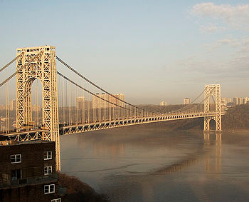
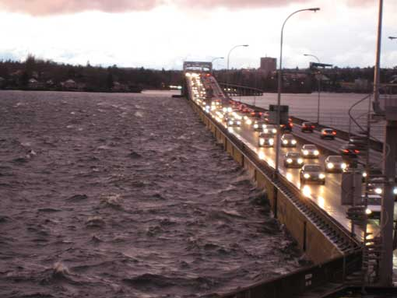
Another Way To Think About “From Here To There”–1
The George Washington Bridge in NYC is the busiest bridge in the world. The tall towers of the suspension structure are sunk into deep foundations in the bed rock below the Hudson River. Construction began six months after I was born. I remember watching the bridge being built when Father drove us along the Hudson on Sunday afternoons in the early 1930s.
Google
This Seattle bridge floats above Lake Washington, carrying huge volumes of I-90 traffic all the way
from the West Coast to the Eastern terminus in Boston. The bridge was designed to float on huge concrete pontoons anchored to the bottom of Lake Washington. The Lake is too deep for suspension towers to reach down to bed rock below the water. Because The Lake and Puget Sound are so deep, the Seattle area has three very large floating bridges.
Google

Slide 43
Another Way To Think About “From Here To There”–2
**
These greatly different ways of building high-traffic bridges demonstrate that imaginative engineers can design successful structures that go beyond the traditional methods of deep foundations, high towers, and long cantilevers.
Can these bridges serve as models for neuro-behavioral studies? These studies frequently involve variable realities. Those realities lie outside the “traffic flows” of traditional natural sciences, which are based on the assumed lawfulness of identified constant properties?
The following page suggests ideas that might have significant bearing on this challenge.

Slide 44
*
It will help us
To Think about
Body and Mind,
About
Constants and Variability
In Science
And about
Baby/Mother Smiles
To start our thinking within these four
“Frame Rails” of Discussion

Slide 45
Frame Rail 1: Critical, Major, Exemplary Knowledge Models
Frame Rail 1: Critical, Major, Exemplary, Knowledge Models
Constants/Variable/Gradients B. Causal Networks C. Metabolism: Anabolism/Catabolism D. Modes of Verification E. Homologies/Analogies F. Denotation & Connotation
G. “Downstream Manifestations”

Slide 46
Frame Rail 1: Critical, Major, Exemplary Knowledge Models
Frame Rail 1: Critical, Major, Exemplary, Knowledge Models
Constants/Variables/Gradients B. Causal Networks C. Metabolism: Anabolism/Catabolism
D. Modes of Verification E. Homologies & Analogies
F. Denotation & Connotation G. “Downstream Manifestations”
Frame Rail 2: Comprehending “Codes of Representation” (Explain)
A. The Many Stages of Evolution B. Socio-Cultural Context
C. Shifting, Conflicting Hierarchies of Status Primacy in Scholarship
Frame Rail 2: Comprehending “Codes of Representation”
The Next Slide
Will Help Us
Check our Orientation to
The Complexity
And
Potential Chaos Among
These Systems.

Slide 47
Frame Rail 1: Critical, Major, Exemplary Knowledge Models
Frame Rail 1: Critical, Major, Exemplary, Knowledge Models
Constants/Variables/Gradients B. Causal Networks C. Metabolism: Anabolism/Catabolism
D. Modes of Verification E. Homologies & Analogies
F. Denotation & Connotation G. “Downstream Manifestations”
Frame Rail 2: Comprehending “Codes of Representation” (Explain)
A. The Many Manifestations* of Evolution B. Socio-Cultural Context
C. Shifting, Conflicting Hierarchies of Status Primacy in Scholarship
*! * ! *
The Many Manifestations* of Evolution
1. The Big Bang
2. Evolution of the Elements & Uni/Multiverse
3. Evolution of the Terrestrial Atmosphere
4. Terrestrial Geomorphic-Oceanic Evolution
5. Emergence of Life on Earth
6. Biological Evolution-Speciation & Extinction
7. Geological Evolution
8. Mammalian Evolution
9. Socio-Cultural Evolution
10. Symbolic Evolution
11. Historical-Generational Evolution (Generation Gaps)
12. Individual Development
*Thanks to Robin Chapman for suggesting this term
Indicates: Evidently
in Progress Now
Frame Rail 2: Comprehending “Codes of Representation”
*! * ! *
*! * ! *
*! * ! *
*! * ! *
*! * ! *
*! * ! *
*! * !
*! * ! *

Slide 48
Frame Rail 1: Critical, Major, Exemplary Knowledge Models
Frame Rail 1: Critical, Major, Exemplary, Knowledge Models
Constants/Variables/Gradients B. Causal Networks C. Metabolism: Anabolism/Catabolism
D. Modes of Verification E. Homologies & Analogies
F. Denotation & Connotation G. “Downstream Manifestations”
Frame Rail 2: Comprehending “Codes of Representation”
A. The Many Stages of Evolution B. Socio-Cultural Context
C. Shifting, Conflicting Hierarchies of Status Primacy in Scholarship
Frame Rail 2: Comprehending “Codes of Representation”
Frame Rail 3: Demystified Human Consciousness
A. Process B. Content C. Attention D. Development
E. Function
Frame Rail 3: Demystified Human Consciousness

Slide 49
Frame Rail 1: Critical, Major, Exemplary Knowledge Models
Frame Rail 1: Critical, Major, Exemplary, Knowledge Models
Constants/Variables/Gradients B. Causal Networks C. Metabolism: Anabolism/Catabolism D. Modes of Verification E. Homologies & Analogies
F. Denotation & Connotation G. “Downstream Manifestations”
Frame Rail 2: Comprehending “Codes of Representation”
A. The Many Stages of Evolution B. Socio-Cultural Context
C. Shifting, Conflicting Hierarchies of Status Primacy
Frame Rail 2: Comprehending “Codes of Representation”
Frame Rail 3: Demystified Human Consciousness
A. Process B. Content C. Attention D. Development E. Function
Frame Rail 3: Demystified Human Consciousness
Frame Rail 4: Individual & Group Minds (B Z F Selection)
A. Darwin / Wallace B. Hitler / Gandhi C. Fred Astaire
D. Leonardo / Michelangelo / Bach / Mozart / Beethoven / Majewski
Who is Lech Majewski ? Why is he on this list?
Frame Rail 4: Individual & Group Minds (B Z F Selection)

Slide 50
Frame Rail 1: Critical, Major, Exemplary Knowledge Models
Frame Rail 1: Critical, Major, Exemplary, Knowledge Models
Constants/Variables/Gradients B. Causal Networks C. Metabolism: Anabolism/Catabolism D. Modes of Verification E. Homologies & Analogies
F. Denotation & Connotation G. “Downstream Manifestations”
Frame Rail 2: Comprehending “Codes of Representation”
A. The Many Stages of Evolution B. Socio-Cultural Context
C. Shifting, Conflicting Hierarchies of Status Primacy in Scholarship
Frame Rail 2: Comprehending “Codes of Representation”
Frame Rail 3: Demystified Human Consciousness
Frame Rail 3: Demystified Human Consciousness
A. Process B. Content C. Attention D. Development E. Function
Frame Rail 4: Individual & Group Minds (B Z F Selection)
A. Darwin / Wallace B. Hitler / Gandhi C. Fred Astaire
D. Leonardo / Michelangelo / Bach / Mozart / Beethoven / Majewski
(Who is Lech Majewski ? Why is he on this list?)
Frame Rail 4: Individual & Group Minds (B Z F Selection)

Slide 51
Frame Rail 1: Critical, Major, Exemplary Knowledge Models
So, I contend that
The concepts stated here contain
Quirky, “difficult”, often neglected, and
Seemingly unrelated components of reality
That must be taken adequately into account
If we are ever to decipher what may be some of
Nature’s Best Kept Secrets.
Frame Rail 2: Comprehending “Codes of Representation”
Frame Rail 3: Demystified Human Consciousness
Frame Rail 4: Individual & Group Minds (B Z F Selection)

Slide 52
Frame Rail 1: Critical, Major, Exemplary Knowledge Models
INFERENCES
This work is guided by the hypothesis that important new insights on relationships among fundamental neural processes and complex human behaviors dependent upon those processes can be gained by thoughtful analysis within the framework presented above.
Analysis and explanation of these categories and sub-categories is a major undertaking, now in progress. I have no doubt that this Framework and these categories and sub-categories require extensive elaboration, explication, and perhaps revision. In my view, all the sub-categories listed here are important, but those printed in magenta are most important.
The remainder of the discussion at the October 15, 2013, presentation for the Chaos and Complex Systems Seminar at the University of Wisconsin is devoted to oral discussion of the sub-categories I regard as most important—those printed in magenta.
B Z F
Frame Rail 2: Comprehending “Codes of Representation”
Frame Rail 3: Demystified Human Consciousness
Frame Rail 4: Individual & Group Minds (B Z F Selection)

Slide 53
Discussion Order
3
Frame Rail 1: Critical, Major, Exemplary, Knowledge Models
Variables, Constants, Gradients B. Causal Networks C. Metabolism: Anabolism/Catabolism D. Modes of Verification E. Homologies & Analogies
F. Denotation & Connotation G. “Downstream Manifestations”
1
Frame Rail 2: Comprehending “Codes of Representation”
A. The Many Stages of Evolution B. Socio-Cultural Context
C. Shifting, Conflicting Hierarchies of Status Primacy in Scholarship
4
Frame Rail 3: Demystified Human Consciousness
A. Process B. Content C. Attention D. Development E. Function
2
Frame Rail 4: Individual & Group Minds (B Z F Selection)
A. Darwin / Wallace B. Hitler / Gandhi C. Fred Astaire
D. Leonardo / Michelangelo / Bach / Mozart / Beethoven / Majewski
Who is Lech Majewski ? Why is he on this list?

Slide 54
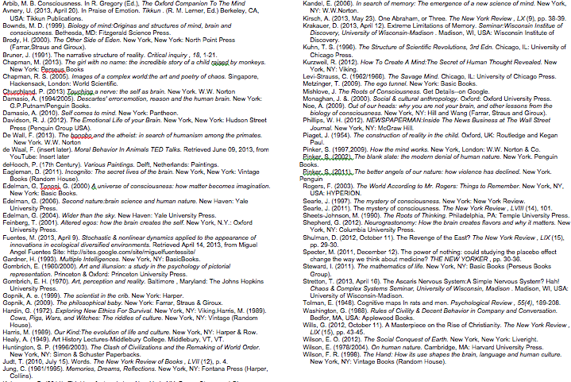
Partial bibliography (September, 2013)

Slide 55
B Z F Professional Identity
January, 2013
Student Roles
Student: Scarsdale Public Schools, K-12 (1944); US Army-Armored Infantry (1945-47); Middlebury College (1950); City College of NY & Fordham U (1957-58); Case Western Reserve U (1958-62); Seattle Pacific U (2001-02).
Professional, Research & Faculty Roles:
The Daily Times, Mamaroneck, N Y, General News Reporter (1951-52); Cambridge University Press, N Y, Assistant to American Director, (1953-55); Case Western Reserve U, Post-Doc & Principal investigator (1962-67); Cleveland State U, Instructor to Asssoc. Professor, (1961-1967); Consultant to Headmaster & Faculty, Hawken School, Cleveland Hts, OH, 1964-67; U of Illinois--Champagne-Urbana, Lecturer,(1967); U Wisconsin-Madison Lecturer, School of Education, ( 1967-70; Research Professor of Human Development-Psychology, U of Hartford (1970-95); Consultant to Hartford Regional Mental Retardation Center, 1970-80; Consultant to State of Connecticut Commissioner of Education, 1972-74; Consultant to U.S. President’s Commission on Mental Retardation, 1973-74;: Lilly Foundation Fellow, Yale University 1976-78}; U of Washington-Seattle ,Visiting Scholar, (1999-2001); U Wisconsin-Madison: Chaos & Complex Systems Seminar, Regularly Contributing Member, 2009—
Research & Project Leadership Roles
Pre-doctoral Fellowships, Behavior Genetics Laboratory, Mental Development Center, Psychology Dept, Case Western Reserve U; Post-doctoral fellowship, Mental Development Center; Founding Director, Infant/Child Language Research Laboratory, Developmental Abilities & Disabilities Research Laboratory, CWRU; UW-Mad, U Hartford; Founding Director, New England Television Research Center, U Hartford; Founding Director, Hartford Studies in Adulthood & Aging, U Hartford.
University Governance Roles
Councils To Advise Trustees on Presidential Selection—Cleveland State University Prex: Harold E. Enerson (1966) & University of Hartford Prex Stephen Joel Trachtenberg (1975); Sabbatical Committee, Promotion & Tenure Council, Intellectual Property Committee—University of Hartford.
Publications
Approximate List: see GOOGLE SCHOLAR. Detailed List: Inquire. Current studies in progress toward publication.
Presentations, Colloquia, Grand Rounds, Conference Participation
Too numerous to list, (1961-current): US, UK, The Netherlands, Italy, Israel, Japan

