Slide 1
Computers, Brains & Minds
&
The Darwin Sequence
Illustrative Examples
Supplementary Sequences
By
Bernard Friedlander & Cameron Holmes
Summer, 2013
Addenda To
From Here To There:
From Lawful Neuroscience
To The Unruly Realities of Every Day Human Adaptation
OR
Are Mother-Infant Smiles
Beacon Lights of Evolution & Civilization?
Bernard Z. Friedlander, Ph.D.
Version 13.10.15PFFF
© Bernard Z. Friedlander 2013
Research Professor of Human Development, Emeritus
Department of Psychology, University of Hartford
Regularly Contributing Member
CCSS—University of Wisconsin-Madison
Chaos & Complex Systems Seminar – Department of Physics
University of Wisconsin-Madison October 15, 2012

Slide 2
Introduction-1
When thinking about the illustrative material that follows, it is important to remember the very highly judgmental statement attributed to George Box, an eminent mathematically based scientific statistician:
All models are false, but some are more useful than others.
This is very significant in our case. Computer modeling of the functions of mind and brain are metaphors, as highly illustrative but ultimately as inexact, as the Poet, Wordsworth’s, famous line,
….I wandered, lonely as a cloud….
Wordsworth was not saying he was a cloud. He was saying he felt like, or as, a cloud: drifting, far away, alone, subject to forces beyond his control. This is highly connotative and suggestive of similarities easily understood. It is a vivid comparison that aids communication and shared understanding of a feeling tone.
It would be deeply wrong to infer that Wordsworth was denoting a fact that at some point in time he actually had been a cloud.

Slide 3
Introduction – 2
In the sequences that follow, it would be equally wrong to make the take away an inference that computer components function in the same way human brains do their work, or that brains function in the same way that computers operate.
The relationship between the two is analogous, not homologous. They each may do similar things, but they go about their work by entirely different means.
There is much value to be gained from thinking of the usefulness of computer models for some of the things brains and minds do in the world. But transistors, circuit boards, imaging & memory systems, display screens, audio cards, scans, and robots are only substitutes– metaphors for and analogs of minds and brains.
They each may do similar things, but they go about their work by entirely different means.
When we fail to recognize differences between analogies and homologies, between connotations and denotations, we may be headed for big trouble.

Slide 4
First Addendum
Computers, Brains & Minds
Slides 1 – 17
Second Addendum
The Darwin Sequence
Slides 18 – 27
These Addenda Are At Their BEST
When your computer displays them in
SLIDE SHOW MODE
Use the position arrows on your keyboard to move the slides forward and backward.
In the Darwin Sequence use the arrows, and allow time for the disks to slide in and out of Darwin’s Head !
Cameron had a good time figuring out how to make that happen; Bernard likes to watch the action.
Those movements illustrate learning and innovation very well.

Slide 5
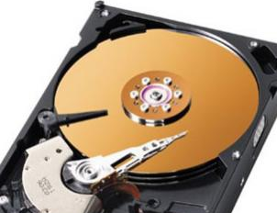
Computers Brains and Minds
COMPUTER DISKS—Modern Computers contain one or more hard-disk drives. Disks do one thing well -- they store changing digital information in a relatively permanent form. Disks are the crucial element that give computers the ability to sort, combine, select and remember things.

Slide 6
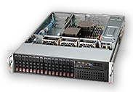
Computers Brains and Minds
Servers combine dozens, hundreds, or thousands of hard drives in very highly complex networks of interactivity.

Slide 7
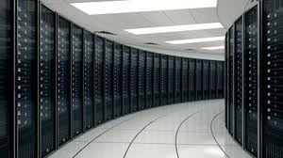
Computers Brains and Minds
Some Computer Server Systems Are Big, Some Very Big.
But None (Yet!) Can Match The Human Mind.

Slide 8
Computers Brains and Minds
Computer information processing systems
Count their information units
In terms of millions,
Tens of millions
&
Hundreds of millions.

Slide 9
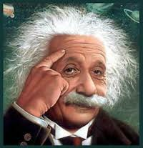
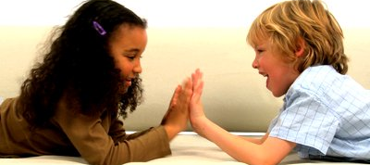
These kinds of information systems…
Albert Einstein--Thinking
...count their information units
In terms of
Tens &
Hundreds of
Billions.
American Children--Playing

Slide 10
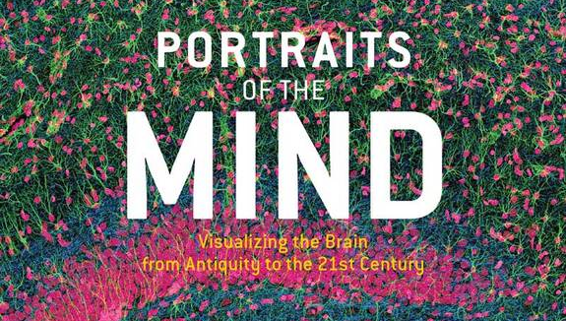
The images that follow are selected from PORTRAITS OF THE MIND by Carl Schoonover (Abrams, 2010.)
These images illustrate just a few of the many different types of
tissues and structures of the brain.

Slide 11
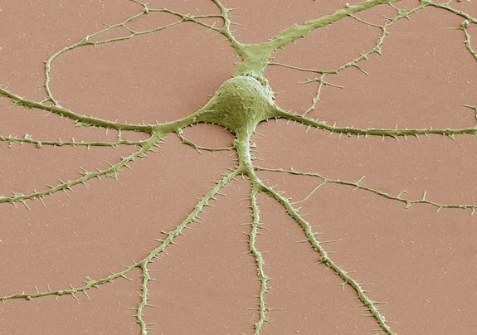
Spiny NeuronCredit: Thomas Deerinck and Mark Ellisman, 2009.Most neurons have three parts: an axon, a cell body called a soma and dendrites. This scanning electron microscope (SEM) image shows a soma with dendrites (and their spines) radiating from it. To create SEM images, a beam of electrons is scanned across the surface of a sample, and a detector keeps track of electrons bouncing off its surface to reveal the specimen's outer shape.

Slide 12
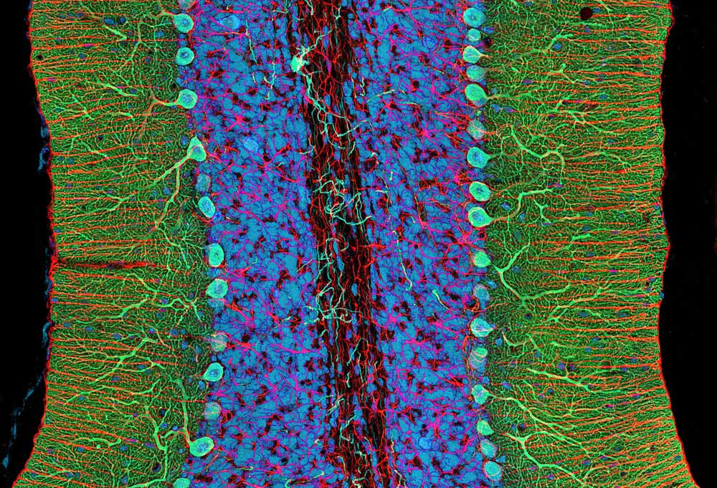
Artsy Brain Cells, 2004.
Here, two types of cells in the cerebellum are shown: glia and Purkinje neurons.
Credit: Thomas Deerinck and Mark Ellisaman

Slide 13
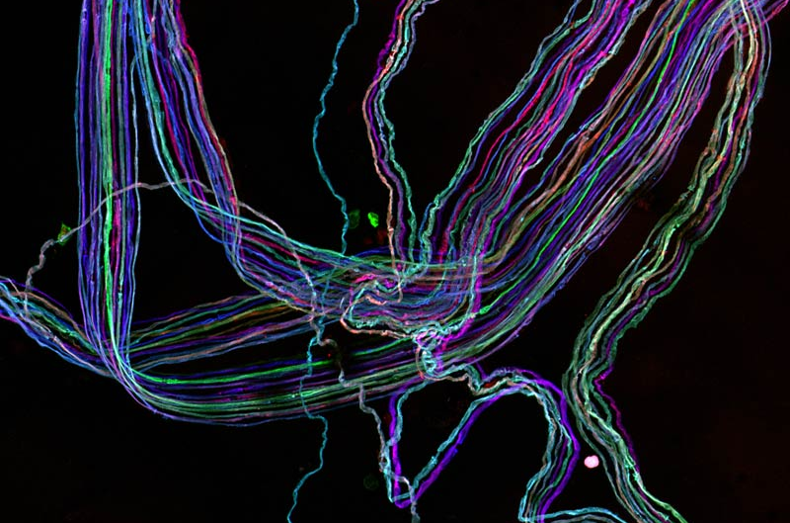
BRAINBOW
By coaxing different sets of neurons or even different individuals of a species…to express different proteins, scientists could pick out the cells by the color they glowed
Credit: Ryan Draft, Jeff Lichtman, and Joshua Sanes, 2007

Slide 14
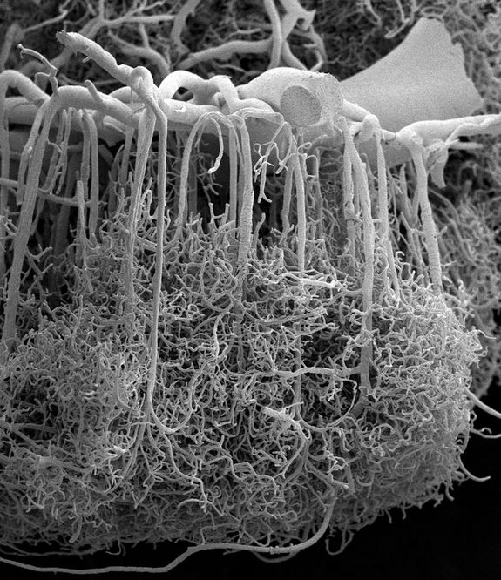
Baroque Blood Vessels
Credit: Alfonso Rodríguez-Baeza and Marisa Ortega-Sánchez, 2009.
A scanning electron microscope (SEM) image zooms in on the baroque branching structures that send blood to the human brain's cortex. The vessels are organized such that the large blood vessels surround the surface of the brain (top of image), sending thin, dense projections down into the depths of the cortex (bottom of image).

Slide 15
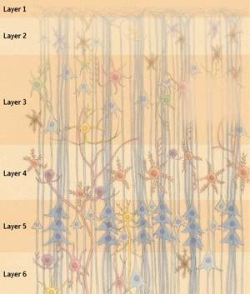
Layers of the Cerebral Cortex
These represent the cells that do all the work of the brain and mind--EVERYTHING
The brain comprises more than 100 billion neurons, which are mutually connected by means of dendritic projections and axons extending from their cell bodies to form an extremely complex network of neural circuits.
Riken Research 29 May 2009 (Vol. 4 Issue 5)

Slide 16
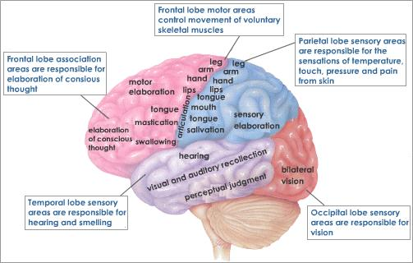
www.tutorvista.com
The Human Cerebral Cortex
A Very Simplisitic Representation

Slide 17
Those brilliant images prepare us to think in analytical terms when we deal with specific mental processes flowing through the brain and mind:
Are there really millions, perhaps billions, of nerve cells sending flickers of electrical messages back and forth across the brain when people engage in the simplest functions of the body and mind ?
The slides that follow illustrate metaphorical, analogical examples of how those electrical messages function in building babies’ awareness of themselves and of the world around them.
These are among the most basic aspects of learning and adaptation in the entire repertoire of human behaviors.

Slide 18

Computers, Brains & Minds
The Most Prodigious Information Gathering System In
All The World of Nature !
This baby’s bright eyes are a sure sign that her or his head is filling up with data very fast.

Slide 19
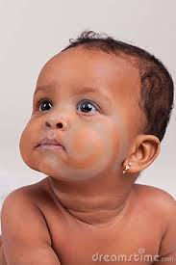
Computers, Brains & Minds
The Most Prodigious Information Gathering System In
All The World of Nature !
Here are just some of the data disks that are starting to fill this baby’s mind.

Slide 20
Friedlander Triangle of Human Consciousness & Behavior:
These Disks Represent Intricately Related Complex Experiential Information Programs,
Each Densely Packed With Essential Data & Tasks
Functional Dynamics
Building Blocks
Developmental Dynamics
Passage of Time
A. Evolutionary Variability
B. Historical Variability
C. Generational Variabiiity
D. Individual Variability
A. Neurological Dynamics
B. Psychological Dynamics
C. Societal Dynamics
D. Cultural Dynamics
A
A
B
B
C
C
D
A
D
B
C
D
E
Representational Dynamics
Affective-Cognitive Processing
A. Sensory Perceptual “Qualia”
B. Conventional
Signs &Symbols
C. Interpersonal
Communication
D. All Forms
Of Media
E. All Popular &
Fine Arts
© 2013 Bernard Z. Friedlander

Slide 21
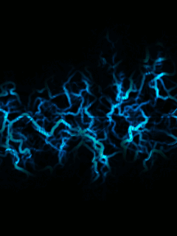
Computers Brains & Minds
Triangle of
Consciousness
& Behavior
The Server
Cabinet of
The Mind
A
A
B
B
C
C
D
A
D
B
C
D
E

Slide 22

Computers, Brains & Minds

Slide 23
Computers, Brains & Minds
A
A
B
B
C
C
D
A
D
B
C
D
E

Slide 24
Computers, Brains & Minds
And Eventually
The information in
Their Disks Will Become
Organized Effectively and
These Two Beautiful Babies
Will Become
Successful
Grown-Ups!

Slide 25
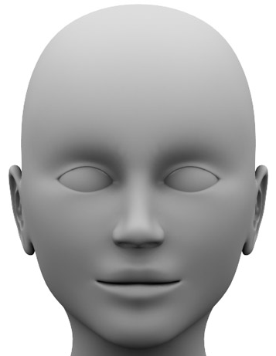
Computers, Brains & Minds
The Server
Cabinet of
The Mind
Any ONE !
EVERYONE !
You
Me
Marian Anderson
J.S. Bach
Ludwig v. Beethoven
Winston Churchill
Cleopatra
Madame Curie
Frederick Douglass
Emily Dickinson
Albert Einstein
Betty Friedan
Martin Luther King
Angelina Jolie
John F. Kennedy
Marilyn Monroe
Wolfgang Mozart
Lee Harvey Oswald
Eleanor Roosevelt
Wm Shakespeare
Meryl Streep
Everyone !
Neuro-Dynamics
Devel-Dynamics
Representations of Self & World

Slide 26
To Access The Following
Extremely Interesting
YOU TUBE Presentation
Follow Either of These Procedures:
If your location and computer can access Wi-Fi, on the next slide,
Make sure your computer is in “Slide Show” Mode, then
Put the computer cursor inside the You Tube gray Rectangle
And click on the YouTube prompt, and then click on the
Full Screen rectangle in the lower right hand corner of the
Part-screen black YouTube display box.
2) If your location and computer do not support Wi-Fi, use some other means to locate and display this YouTube presentation.
www.youtube.com/watch?v=6LWz4qa2XQA&feature=yout
Believe me: seeing this University of Minnesota Engineering Triumph
Is worth the trouble of seeking it out !
It is highly appropriate to what this University of Wisconsin Presentation
On Computers, Brains and Minds is all about !

Slide 27


Slide 28
The Darwin Sequence
Slides 28– 36

Slide 29
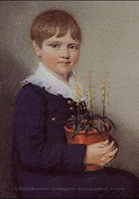
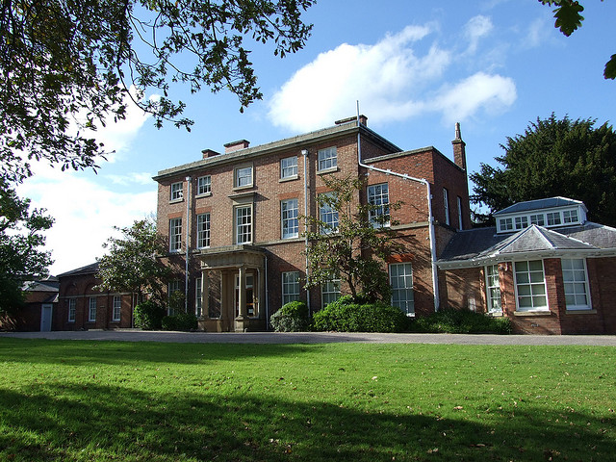
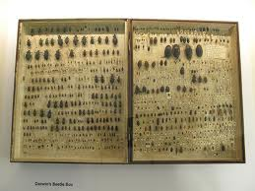
Darwin’s Early Life:
His Childhood Experiences Represented as Memories
Stored As Data On Computer Disks
“…from an early age Charles will have become familiar with the plants and animals in the garden”.
Early Darwin Beetle Collection
Young Darwin
The Mound, Sussex, England
∨
∨
∨
Benign Childhood
Supportive Family
Early Start

Slide 30
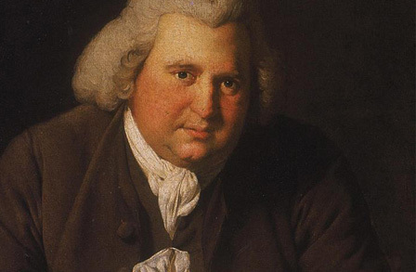
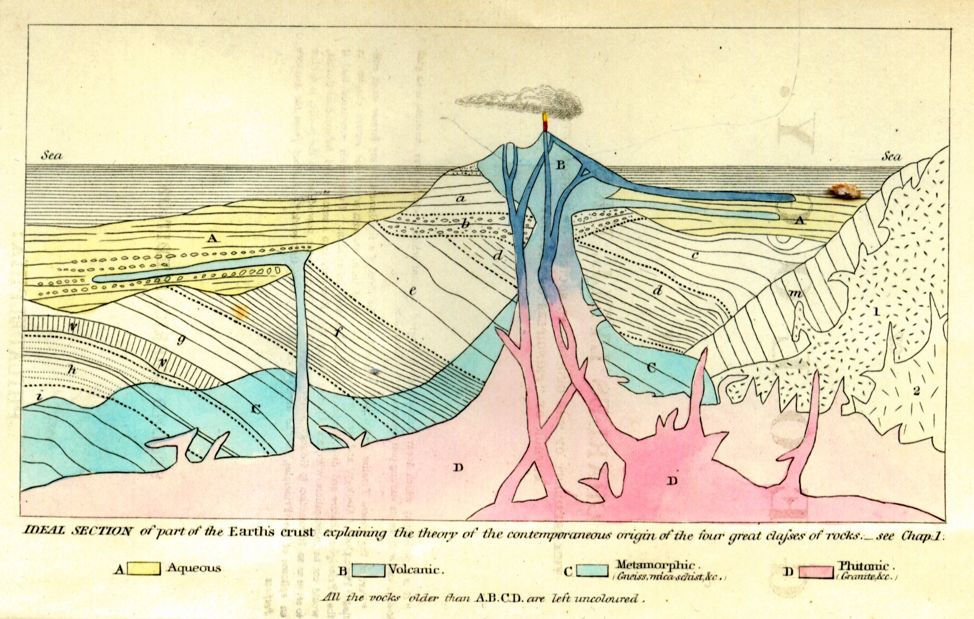
Darwin’s Early Life
Additional Critical Data, and Two More Disks:
Young Charles’ Grandpa, and A Very Important Book
Erasmus Darwin, 1731-1802
An Early Theorist on Variations in Species &
Selective Breeding in Plants, Agriculture &
Domestic Animals
Sir Charles Lyell, Principles of Geology, 1830
New Images of the Age and Complexity of Planet Earth
& Hesitant Challenges to “Sacred” Biblical Narrative
∨
∨
Family Tradition of Intellectual Ferment
Turbulent Times

Slide 31
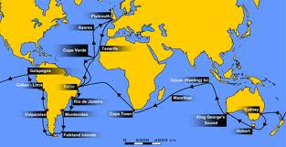
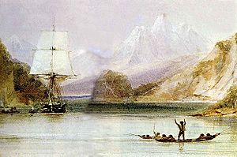
Darwin’s Big Chance:
The Voyage of The Beagle
The Route—1831-1836
A watercolour by HMS Beagle's draughtsman, Conrad Martens. Painted during the survey of Tierra del Fuego, it depicts the Beagle being hailed by native Fuegians.

Slide 32
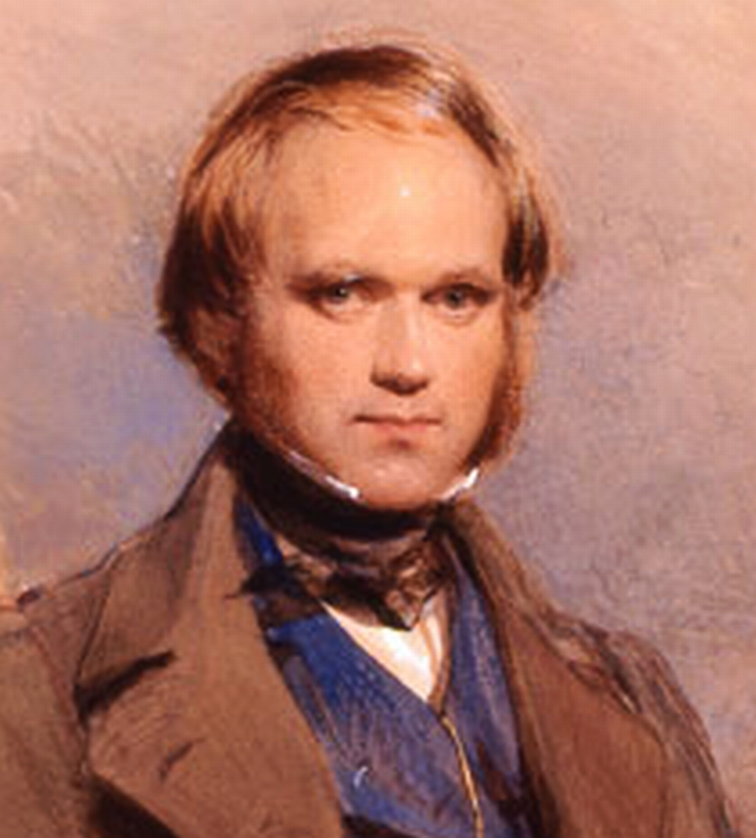
South
South
American
American
Geology
Flora
South
Galapagos
American
Finches
Fauna

Slide 33
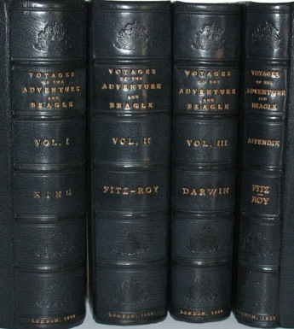
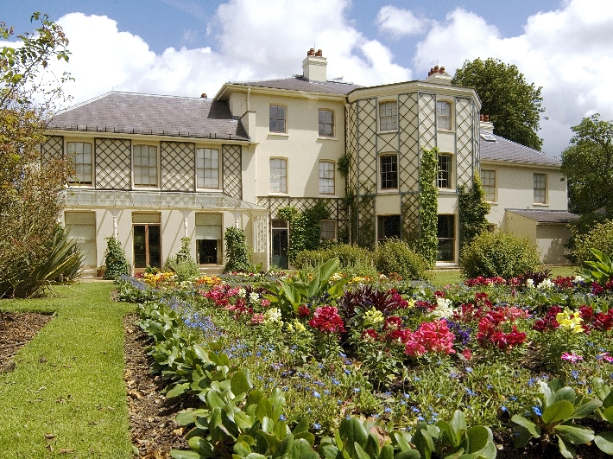
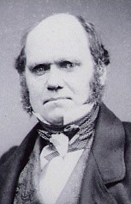
Home from Beagle voyage
Darwin’s Home at Down House, Kent, England
Darwin at Home
Processing Beagle Voyage
1840s – 1850s
Darwin
1850s

Slide 34

Natural
Variation
Competition
Environmental
Adaptation
Natural
Selection

Slide 35
! The Origin of Species !
! Evolution !

Slide 36
The End
For additional information on Bernard Friedlander’s various projects address e-mail inquiries to bzf202@gmail.com.

